Slide 1
Access and Equity: Module 3
Challenges and Issues in Addressing Diversity
Notes:
In this module, you will learn about challenges and issues in addressing diversity.

Slide 2
Description of Module: Addressing Diversity
This module:
Examines our thinking about the diversity of our student population.
Encourages us to examine and reflect upon our own preconceptions about who benefits from highly capable services.
Forces us to question traditional paradigms of characteristics of gifted students and causes us to reflect upon the relationship between language, culture, economic status, family background, and/or area of disability and learning.
Participants will learn about current research and effective practices for addressing the needs of diverse populations of students in need of highly capable services.
Most importantly, this module emphasizes the need to provide access and equity to students from all populations who need highly capable services.
Notes:
Module 3 examines our thinking about the diversity of our student population. How we think about who benefits from highly capable services colors our lenses when we look for strengths and talents in our students.
Examining diversity forces us to question the characteristics traditionally attributed to gifted students and causes us to reflect upon the relationship between language, culture, economic status, family background, or area of disability and learning. Participants will learn about current research and effective practices for addressing the needs of diverse student populations who are in need of highly capable services. Most importantly, this module emphasizes the need to provide access and equity to students from all populations who need highly capable services.

Slide 3
Alignment with NAGC-CEC
This module aligns with the following NAGC-CEC Teacher Preparation Standards in Gifted Education- Standard 4: Assessment (NAGC, 2013).
Professionals understand how language, culture, economic status, family background, and/or area of disability can influence the learning of individuals with gifts and talents.
Professionals understand that some groups of individuals with gifts and talents have been underrepresented in gifted education programs and select and use technically sound formal and informal assessments that minimize bias in identifying students for gifted education programs and services.
Upon completion of this module, participants will be able incorporate best practices from the field on identifying diverse learners for appropriate highly capable services.
Notes:
This module aligns with the following NAGC-CEC Teacher Preparation Standards in Gifted Education- Standard 4: Assessment.
Professionals understand how language, culture, economic status, family background, and/or area of disability can influence the learning of individuals with gifts and talents.
Professionals understand that some groups of individuals with gifts and talents have been underrepresented in gifted education programs and select and use technically sound formal and informal assessments that minimize bias in identifying students for gifted education programs and services.

Slide 4
Access and Equity
Notes:
Picture Source: http://7-themes.com/data_images/out/39/6901291-free-crayon-wallpaper.jpg
The American school population grows more diverse by the day. Growing diversity can, in part, be attributed to immigration, the rates of which have increased considerably in the last few decades. Approximately 13 percent of the general population were identified as foreign-born according to the 2010 American Community Survey (Grieco et al., 2012). . One in five public school students come from immigrant households. Steven Camarota, director of research for the Center for Immigration Studies, found that 78 percent of students in immigrant households speak a language other than English at home. (Camarota, 2012). The US Census Bureau projected that racial and ethnic minorities will make up more than 50% of all American children by 2020, and America will have a majority-minority total population by 2044 (Colby & Ortman, 2015).
However, this diversity is not proportionately represented in Washington state highly capable education programs nor in similar programs across the nation. Gifted education programs are primarily comprised of European American and certain nationalities of Asian American students, typically from higher-income families. According to Siegle and colleagues, groups generally under represented include African Americans, Hispanic Americans, Southeast Asian Americans and Pacific Islanders, Native Americans, and students identified as English learners, twice exceptional, low-income, and/or rural (Siegle et al., 2016). In particular, English learners are the least represented (Matthews, 2014).
We recognize that advanced abilities and academic needs are present in all children regardless of their backgrounds and life situations. When we continually see specific groups of students underrepresented or overlooked in gifted programs, the problem is one of access and equity.
There are three things we must do in order to improve access and equity.
Rethink how we assess and identify children, especially those from diverse backgrounds
Determine whether methods and services ultimately match instructional needs
Improve our cultural competency to better serve all students.
References:
Camarota, S.A. (2012). Immigrants in the United States: A Profile of American’s Foreign-Born population. Retrieved from the Center for Immigration Studies website, http://www.cis.org/sites/cis.org/files/articles/2012/immigrants-in-the-united-states-2012.pdf.
Colby, S. L., & Ortman, J. M. (2015, March). Projections of the size and composition of the U.S. population: 2014 to 2060, Current Population Reports (Report No. P25-1143). Retrieved from the U.S. Census Bureau website, https://www.census.gov/content/dam/Census/library/publications/2015/demo/p25-1143.pdf
Grieco, E.M., Acosta, Y.D., de la Cruz, P., Gambino, C., Gryn, T., Larsen, L.J.,…Walters, N.P. (2012). The foreign-born population in the United States: 2010. Retrieved from the U.S. Census Bureau website, http://www.census.gov/prod/2012pubs/acs-19.pdf.
Humes, K. R., Jones, N. A., & Ramirez, R. R. (2011, March). Overview of race and Hispanic origin: 2010 (Report No. C2010BR-02). Retrieved from the U.S. Census Bureau website, http://www.census.gov/prod/cen2010/briefs/c2010br-02.pdf
Matthews, M. S. (2014). Advanced academics, inclusive education, and English language learners. In M. S. Matthews & J. A. Castellano (Eds.), Talent development in English language learners (pp 11-14). Waco, TX: Prufrock Press.
Siegle, D., Gubbins, J. E., O’Rourke, P., Langley, S. D., Mun, R. U., Luria, S. R., Little, C. A., McCoach, D. B., Knupp, T., Callahan, C. M., & Plucker, J. A. (2016). Barriers to underserved students’ participation in gifted programs and possible solutions. Journal for the Education of the Gifted. Advance online publication. doi:10.1177/0162353216640930

Slide 5
Module Objectives
Explore how diversity impacts access and equity to highly capable services
Challenge your own personal beliefs about conceptions of giftedness and who should be served in highly capable programs
Become familiar with evidence-based practices on identifying diverse advanced learners for appropriate highly capable services
Develop and design an identification plan that incorporates best practices in the identification of students from diverse populations from a strengths-based approach
Notes:
These are the major objectives for this module:
Explore how diversity impacts access and equity to highly capable services
Challenge your own personal beliefs about conceptions of giftedness and who should be served in highly capable programs
Become familiar with evidence-based practices on identifying diverse advanced learners for appropriate highly capable services
Develop and design an identification plan that incorporates best practices in the identification of students from diverse populations from a strengths-based approach
Upon completion of this module, participants will be able incorporate best practices to identify diverse learners for highly capable services.

Slide 6
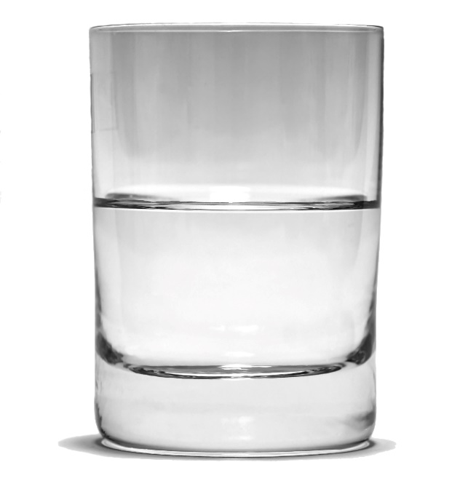
Which One Are you?
½ Empty ½ Full
Notes:
Picture Source: http://www.teamhughesrealestateschool.com/is-the-glass-half-full-or-is-it-half-empty/
Disadvantaged. Learning deficits. Achievement gap. Limited English Proficient. What images do these words conjure up for you?
How about these words: Advantaged. Strengths and talents. Multilingual?
How we think and talk about children influences how we interact with them and how they learn. Our beliefs matter! Having high expectations for children can positively impact their school performance and help nurture their gifts. This has been called a self-fulfilling prophecy or Pygmalion effect. On the flip side, low expectations can negatively influence a student’s academic outcomes.

Slide 7
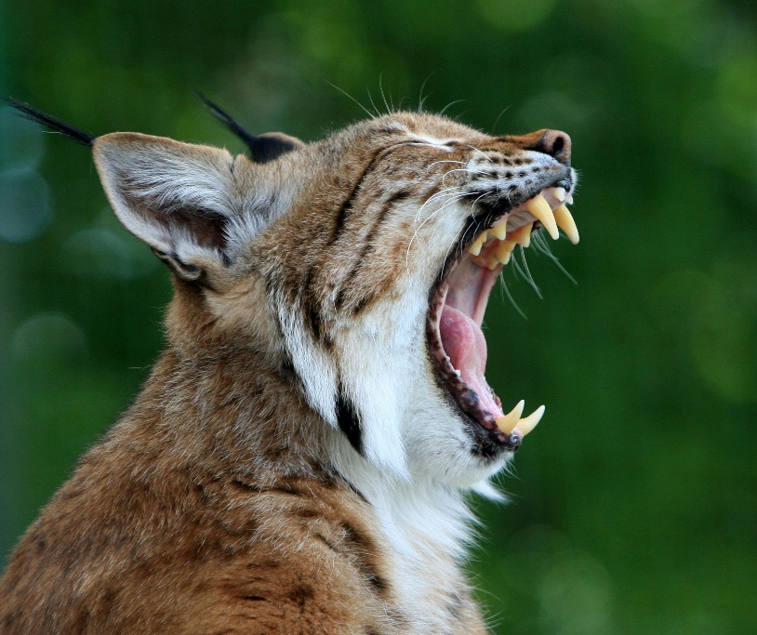
Beliefs Matter!
If you change the way you look at things, the things you look at change
-Wayne Dwyer
Notes:
Picture Source: http://reology.org/2011/08/change-the-way-you-look-at-things-and-the-things-you-look-at-change/
Psychologist Carol Dweck (2006) talks about implicit beliefs in ability and how beliefs can influence achievement. Mindsets act as a “psychological lens” (p. 312) or filter that influences how we think and act (Yeager & Dweck, 2012).
In a fixed mindset, an individual conceptualizes ability as unchangeable and innate. This is also called the entity theory. According to Dweck (2014), Talents and abilities are viewed as fixed and unchanging and these beliefs lead to an overemphasis on innate ability. Individuals with a fixed mindset fear setback because it is interpreted as a lack of ability. In a growth mindset, an individual sees ability as malleable with room for improvement. This is known as the incremental theory (Subotnik, Robinson, Callahan, & Gubbins, 2012; Yeager & Dweck, 2012). The emphasis then is on improving, growing, and learning from challenges.
As educators, it matters what type of mindsets we have when we work with students, particularly students from diverse populations with a range of abilities. We should strive to have a growth mindset and see the potential for growth in all our children.
WHAT IS YOUR MINDSET?
References:
Dweck, C. (2006). Mindset: The new psychology of success. New York, NY: Random House.
Dweck, C. (2014). Teachers’ mindsets: “Every student has something to teach me.” Educational Horizons, 93(2), 10-15. doi: 10.1177/0013175X14561420
Subotnik, R. F., Robinson, A., Callahan, C. M., & Gubbins, E. J. (Eds.). (2012). Malleable minds: Translating insights from psychology and neuroscience to gifted education. Storrs, CT: National Center for Research on Giftedness and Talent.
Yeager & Dweck (2012). Mindsets that promote resilience: When students believe that personal characteristics can be developed. Educational Psychologist, 47(4), 302-314.
Readings/Resources:
Dweck, C. (2014). Teachers’ mindsets: “Every student has something to teach me.” Educational Horizons, 93(2), 10-15. doi: 10.1177/0013175X14561420
Dweck, C. (2006). Mindset: The new psychology of success. Random House.
Yeager & Dweck (2012). Mindsets that promote resilience: When students believe that personal characteristics can be developed. Educational Psychologist, 47(4), 302-314.

Slide 8
Assignment 1: Reflection—Examining Mindsets
Reflect on how you, your colleagues, or your administration think and talk about children. How about children from diverse populations? What mindsets do you have?
Now ask yourself, who is in your highly capable program? Does it match your district demographics?
What are the implications of your findings?

Slide 9
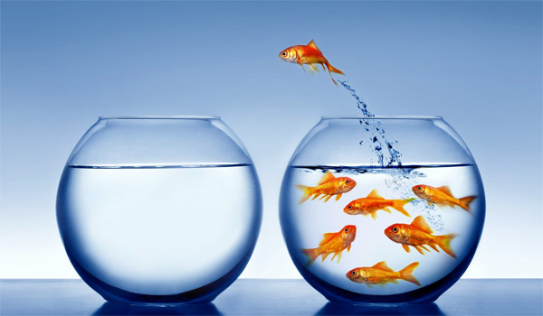
Paradigm Shift
Best practices involve a fair and equitable referral process which requires a paradigm shift. Rather than identifying and remediating weaknesses in students, we shift our focus to identifying strengths and examining giftedness through multiple lenses
Notes:
As discussed, we all have a set of internal beliefs and mindsets that guide our thoughts and behaviors. Unfortunately, diverse learners are often associated with deficits rather than strengths, and thus have a higher chance of being overlooked for advanced academic work and other gifted services. For example, ethnically, culturally and linguistically diverse learners may be associated with lower intelligence due to historical group performance on IQ tests. In particular, low performance of Black students have led some authors to conclude that “Blacks are intellectually inferior” while others argue that the problem rests on the tests themselves and test bias (Ford & Grantham, p. 218). What is likely is that if educators have fixed mindsets about intelligence and believe that Black students are intellectually inferior, then they are not likely to refer them for gifted services.
Likewise, educators may have a certain deficit perception of children with disabilities. Among these perceptions are that children with disabilities do not qualify for gifted services, are unable to keep up in class, need special attention, or lack necessary communication or social skills. These perceptions make teachers less likely to refer twice exceptional children for gifted services, especially those on the autism spectrum.
English learners in particular are the most overlooked group of all diverse students. This is partly due to identification procedures that require advanced English fluency, and partly due to educator beliefs about who would thrive in gifted programs (Mun et al., 2016).
According to a systematic review of the literature conducted by the National Center for Research on Gifted Education, teachers may overlook academic potential in English learners due to “(a) a strong valuing of the English language as a characteristic of giftedness, and (b) a cultural bias in what ‘giftedness’ should look like in children, with a tendency to favor behaviors that reflect dominant culture values such as individualism and verbal expression” explains (Mun et al., 2016, p. 35). In the examples provided, we see how important it is that educators experience a paradigm shift from a deficit framework to a strength-based framework.
References:
Ford, D. Y., & Grantham, T. C. (2003). Providing access for culturally diverse gifted students: From deficit to dynamic thinking. Theory Into Practice, 42, 217-225. doi:10.1207/s15430421tip4203_8
Mun, R. U., Langley, S. D., Ware, S., Siegle, D., Gubbins, J. E., McCoach, D. B.,…Callahan, C. M. (2016). Effective practices for identifying and serving English Learners in gifted education: A systematic review of the literature. Unpublished manuscript.

Slide 10
Changing Deficit Thinking to Dynamic Thinking
Intelligence – Measure using multiple intelligences and areas of strength.
Testing & Assessment – Use multiple criteria and holistic understanding of child.
Communication/Relationships with Diverse Families & Communities – Proactively build relationships with families & communities.
Policies and Practices – Professional development for identification, consider universal screening.
Notes:
Ford and Grantham (2003) discussed how deficit thinking about diverse students “hinders access” to gifted services (p. 217). They list 8 areas of deficit thinking that can be changed into dynamic thinking. Highlighted below are several, with our own recommendations:
Intelligence
Shift from rigid definitions (i.e. IQ-equates-giftedness) to acknowledgement of multiple intelligences and areas of strength
Testing and Assessment
Shift from overreliance on cut-off scores for standardized ability and achievement tests, to exploring multiple objective criteria (and weighting) to understand children more holistically
Communication/relationships with Diverse Families and Communities
Family involvement is crucial in student achievement and particularly for diverse learners who may feel comfortable in the dominant language or culture—shift to proactively and aggressively building relationships and networks with families and communities
Policies and Practices
Teachers can act as gatekeepers—we need to increase professional development in identification and consider universal screening
District policies with gifted enrollment limits—in the state of Washington, access to advanced and accelerated instruction is considered basic education for highly capable. So, does it make sense for example, to limit gifted services to 5-6% of the student population? Can we rationalize limiting education services to students even if they need it?

Slide 11
Funds of Knowledge
Notes:
Strengths-Based Framework
We acknowledge that students bring unique strengths, and we understand that development is dynamic, not static or fixed.
Funds of Knowledge
Recent movements in education literature have emphasized strengths rather than deficits (Aldridge, 2008; Ford & Grantham, 2003). Additionally, the cultural or social capital (i.e., cultural or social) that “disadvantaged” students bring with them has become a focus as well, found (Coleman, 1988; Noguera, 2004). For example, funds of knowledge is a term used “to refer to these historically accumulated and culturally developed bodies of knowledge and skills essential for household or individual functioning and well-being” (Moll, Amanti, Neff, & Gonzalez, 1992, p.133).
Using this framework, diverse advanced learners can be viewed as possessing a wealth of previous knowledge, ability, skill, and fluency in multiple languages.
Teachers’ emphasis on verbal ability may also reflect what they understand are necessary abilities for students to succeed in the school’s gifted programs. If we focus on domain specific giftedness, then students who are still learning English may still have opportunities to flourish in areas such as mathematics. Again, the issue is matching services with an identification process where students’ strengths are emphasized.
References:
Coleman, J. S. (1988). Social capital in the creation of human capital. American Journal of Sociology, 94, S95-S120.
Ford, D. Y., & Grantham, T. C. (2003). Providing access for culturally diverse gifted students: From deficit to dynamic thinking. Theory Into Practice, 42, 217-225. doi:10.1207/s15430421tip4203_8
Moll, L. C., Amanti, C., Neff, D. & Gonzalez, N. (1992). Funds of knowledge for teaching: Using a qualitative approach to connect homes and classrooms. Theory Into Practice, 31, 133-141.
Noguera, P.A. (2004). Social Capital and the Education of Immigrant Students: Categories and Generalizations. Sociology of Education, 77(2), 180-183.

Slide 12
Cultural Competency
Valuing Diversity
Being Culturally Self-Aware
Dynamics of Difference
Knowledge of Students’ Culture
Institutionalizing Cultural Knowledge and Adapting to Diversity
(Diller & Moule, 2005)
Notes:
Changing our mindsets is part of developing cultural competency and becoming culturally responsive educators.
Changing our mindsets is part of developing cultural competency and becoming culturally responsive educators.
The National Education Association says, “Cultural competence is the ability to successfully teach students who come from a culture or cultures other than our own. It entails developing certain personal and interpersonal awareness and sensitivities, understanding certain bodies of cultural knowledge, and mastering a set of skills that, taken together, underlie effective cross-cultural teaching and culturally responsive teaching.” Cultural competency does not develop through a single reading or day worth of training. It takes self-reflection, consistent effort, education, training, and application over time. There are five basic cultural competence skill areas according to Diller and Moule’s, Cultural Competence: A Primer for Educators, Thomson Wadsworth 2005):
Valuing Diversity. Accepting and respecting differences, including different cultural backgrounds and customs, different ways of communicating, and different traditions and values.
Being Culturally Self-Aware. Culture is the sum total of an individual's experiences, knowledge, skills, beliefs, values, and interests. It shapes educators' sense of who they are and where they fit in their family, school, community, and society.
Dynamics of Difference. Knowing what can go wrong in cross-cultural communication and how to respond to these situations.
Knowledge of Students' Culture. Educators must have some base knowledge of their students' culture so that student behaviors can be understood in their proper cultural context.
Institutionalizing Cultural Knowledge and Adapting to Diversity. Culturally competent educators, and the institutions they work in, can take a step further by institutionalizing cultural knowledge. This allows them to adapt to diversity and better serve diverse populations.
References:
Diller, J. V., & Moule, J. (2005). Cultural competence: A primer for educators. Belmont, CA: Thomson/Wadsworth.
National Education Association: http://www.nea.org/tools/30402.htm

Slide 13
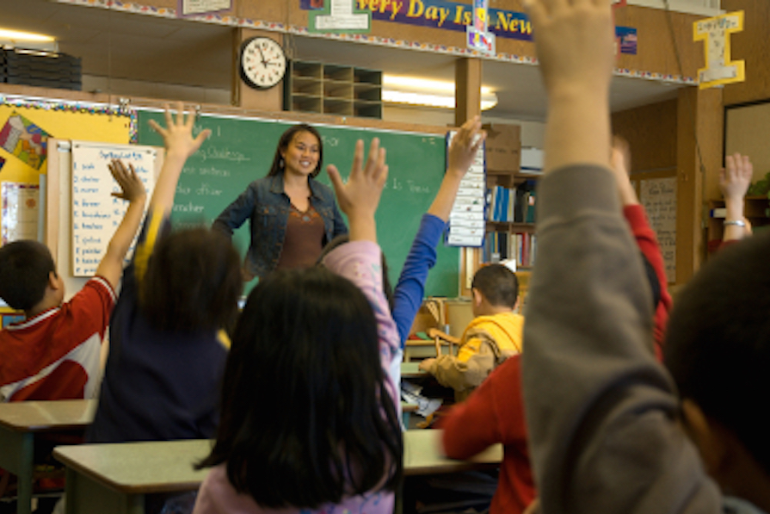
Culturally Responsive Teaching
“…using the cultural knowledge, prior experiences, frames of reference, and performance styles of ethnically diverse students to make learning encounters more relevant to and effective for them” (Gay, 2010, p.31)
Notes:
Culturally responsive teaching uses “the cultural knowledge, prior experiences, frames of reference, and performance styles of ethnically diverse students to make learning encounters more relevant to and effective for them” (Gay, 2010, p.31).
Brown University’s website on culturally responsive teaching references Ladson-Billings, who say,
“Some of the characteristics of culturally responsive teaching are:
Positive perspectives on parents and families,
Communication of high expectations,
Learning within the context of culture,
Student-centered instruction,
Culturally mediated instruction,
Reshaping the curriculum,
Teacher as facilitator.”
References
Gay, G. (2010). Culturally responsive teaching: Theory, research, and practice (2nd ed.). New York, NY: Teachers College Press.
Gay, G. (2013). Teaching to and through cultural diversity. Curriculum Inquiry, 43, 48–70. doi: 10.1111/curi.12002
Ladson-Billings, G. (1994). The dreamkeepers. San Francisco: Jossey-Bass Publishing Co.
Brown website: https://www.brown.edu/academics/education-alliance/teaching-diverse-learners/strategies-0/culturally-responsive-teaching-0

Slide 14
Terms and Definitions
Federal Definition
State Definitions
Notes:
The federal government defines gifted students as “Students, children, or youth who give evidence of high achievement capability in areas such as intellectual, creative, artistic, or leadership capacity, or in specific academic fields, and who need services and activities not ordinarily provided by the school in order to fully develop those capabilities” (No Child Left Behind, 2002). However, there is no federal mandate to identify or provide services for gifted learners (Castellano & Matthews, 2014). Instead, it is up to the states to do so, said the Council of State Directors of Programs for the Gifted and National Association for Gifted Children, 2013). This means that how students are defined, identified, and served may vary by state, district, and school depending on the legislative policies of each state (Stephens, 2008).
References
Castellano, J. A., & Matthews, M. M. (2014). Legal issues in gifted education. In J. P. Bakken, F. E. Obiakor, & A. F. Rotatori (Eds.), Gifted education: Current perspectives and issues (pp. 1-19). UK: Emerald Group Publishing.
Council of State Directors of Programs for the Gifted and National Association for Gifted Children. (2013). State of the states in gifted education: National policy and practice data [CD-ROM]. Washington, DC: National Association for Gifted Children.
No Child Left Behind (NCLB) Act of 2001, Pub. L. No. 107-110, § 115, Stat. 1425 (2002).
Stephens, K. R. (2008). Federal and State Response to the Gifted and Talented. Journal of Applied School Psychology, 27(4), 306-318. DOI: 10.1080/15377903.2011.615823

Slide 15
Washington State Definition: Students Who are Highly Capable
Highly capable students are students who perform or show potential for performing at significantly advanced academic levels when compared with others of their age, experiences, or environments. Outstanding abilities are seen within students’ general intellectual aptitudes, specific academic abilities, and/or creative productivities within a specific domain. These students are present not only in the general populace, but are present within all protected classes according to chapters 28A.640 and 28A.642 RCW.
WAC 392-170-035
Notes:
In Washington State, recent legislative changes to the Washington Administrative Codes (WACs) have made clear that for gifted students, “access to accelerated learning and enhanced instruction is considered access to a basic education.” (WAC 392-170-012). In other words, students identified as gifted or highly capable require accelerated or specialized instruction to learn and grow. The State recognizes that highly capable students “perform or show potential for performing” at more advanced academic levels compared to their peers and that these students are present in all populations including protected classes (WAC 392-170-012). The WACs also stress the importance of using “multiple objective criteria” for identification purposes and that “There is NO SINGLE Prescribed method for identification” (WAC 392-170-055). While the WACs provide guidelines, the individual districts decide how to implement their gifted programs and what multiple objective criteria to utilize.
Readings:
A Primer on the Wacs (Cheatsheet)
Akin, C., Chung, R. U., & Hertzog, N. B. (Eds.). (2015). Highly Capable Program Handbook. Retrieved from https://robinsoncenter.uw.edu/2015/06/new-educators-highly-capable-program-handbook/

Slide 16
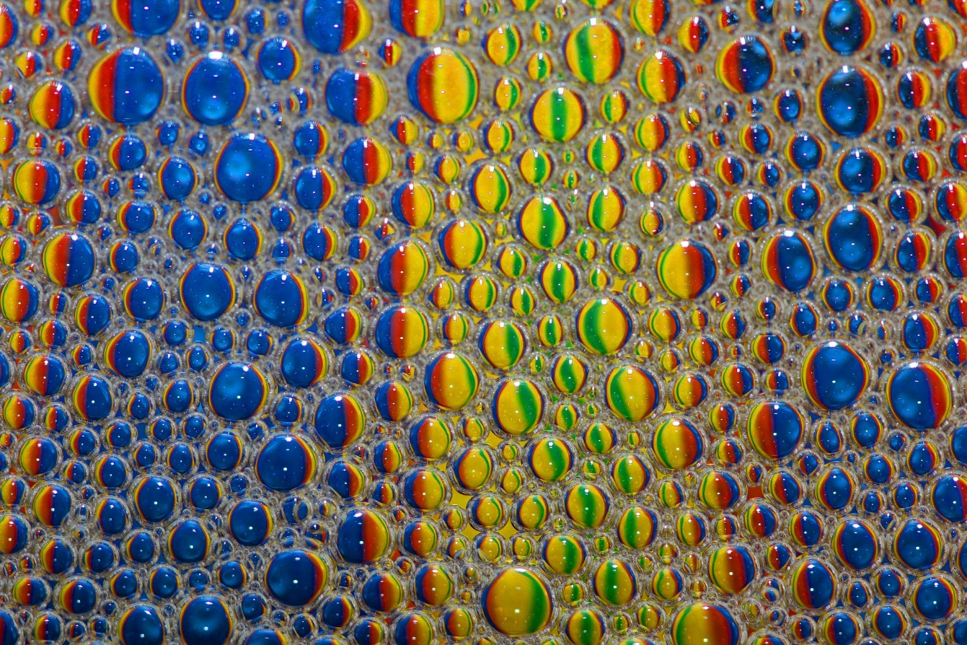
Irrelevant: Bright Vs Gifted
Notes:
You may be familiar with the bright vs gifted chart, which appeared in a 1989 article in Challenge Magazine by Janice Szabos. If not, the chart is a list of descriptors differentiating between a bright child and a gifted learner.
The question is not about whether a child is bright or gifted. The question we should ask is: Who needs advanced learning, bright or gifted? [Pause] If you said both, that is correct!
Challenge and growth in learning should be the goal. The distinction of whether or not a person is gifted vs. “just bright” is not relevant in the field of K-12 education (Peters, 2014). Ultimately, we are concerned with “optimal match.” Instruction, curriculum, and education setting should represent advanced learners needs, (Robinson & Robinson, 1982; VanTassel-Baska, 2014).
References:
Peters, S. J. (2014, July 10). The bright vs. gifted comparison: A distraction from what matters. Creativity Post. Retrieved from http://www.creativitypost.com/education/the_bright_vs._gifted_comparison_a_distraction_from_what_matters.
Robinson, N. M., & Robinson, H. B. (1982). The optimal match: Devising the best compromise for the highly gifted student. In D. Feldman (Ed.), New directions for child development: Developmental approaches to giftedness and creativity (pp. 79-94). San Francisco, CA: Jossey-Bass.
Szabos, J. (1989). Bright child, gifted learner. Challenge, 34. Good Apple.
http://www.ode.state.or.us/teachlearn/specialty/tag/r5brightchild.pdf (chart)
VanTassel-Baska, J. (2014). Matching curriculum, instruction, and assessment for the gifted. In J. A. Plucker & C. M. Callahan (Eds.), Critical issues and practices in gifted education (pp. 377-385). Waco, TX: Prufrock Press.

Slide 17
Multicultural Conceptions of Giftedness
Notes:
“Different cultures have different conceptions of what it means to be gifted. But in identifying children as gifted, we often use only our own conception, ignoring the cultural context in which the children grew up. Such identification is inadequate and fails to do justice to the richness of the world's cultures.” (Sternberg, 2006)
For Taiwanese Chinese, their conception of intelligence may include interpersonal and intrapersonal skills or self-understanding (Sternberg, 2006). Achievement motivation in East Asian contexts reveal an emphasis of effort over ability as compared to Western contexts, which typically focus more on the individual’s ability. In Korea, there is a saying sugohaseyo, which translates to keep working hard. It is often used in educational and work contexts. Encapsulated in this phrase is the idea that one can always work harder (Chung, 2015).
In Australia and New Zealand, there is a strong emphasis on egalitarianism, which stems from a history of settlement by “English freemen and convicts.” This has created a “culture of resentment towards successful individuals” and high achievers or “tall poppies.” These high achievers are then “’cut down to size’ by those who are less successful in order to ‘normalize them.’” (O’Neill, Calder, & Allen, 2014).
In Black American culture, “Acting White is a term frequently used by Black students in a derogatory manner to point out and attack another Black students’ connection with perceived White students’ values, norms, beliefs, attitudes, styles, and preferences” (p. 178) Black students were deemed ‘acting white’ if they obtained good grades, were deemed smart, or participated in advanced and honors courses (Grantham & Biddle, 2014).
Emphasize giftedness as social construct (Borland, 2005).
References/Readings:
Borland, J. H. (2005). Gifted education without gifted children: The case for no conception of giftedness. In R. J. Sternberg & J. E. Davidson (Eds.), Conceptions of giftedness (pp. 1-19). New York, NY: Cambridge University Press.
Chung, R. U. (2015). Parental expectations for Asian American men who entered college early: Influences on their academic, career, and interpersonal decision-making (Unpublished doctoral dissertation). University of Washington, Seattle.
Grantham, T. C., & Biddle, W. H. (2014). From bystander to upstander teacher for gifted black students accused of acting white. Gifted Child Today, 37 (3), 178-187.
O’Neill, M., Calder, A., & Allen, B. (2014). Tall poppies: Bullying behaviors faced by Australian high-performance school-age athletes. Journal of School Violence, 13, 210-227.
Sternberg (2007). Cultural concepts of giftedness. Roeper Review, 29, 160-165.

Slide 18
Assignment 2: Reflection – Conceptions of Giftedness
Reflect on your personal conception of who would benefit from highly capable services. Take a minute to write or visually represent this.
How is the personal conception challenged by what you have just learned about the impact of diversity on conceptions of giftedness?
How does your program serve students “who perform” and students who “show potential?”

Slide 19
Stop and Pause: Read
Read the following article about diverse learners and the barriers they typically experience in accessing gifted education before proceeding to the next section of this module.
Siegle, D., Gubbins, J. E., O’Rourke, P., Langley, S. D., Mun, R. U., Luria, S. R., Little, C. A.,…Plucker, J. A. (In press). Barriers to underserved students’ participation in gifted programs and possible solutions. Journal for the Education of the Gifted. Advance online publication. doi:10.1177/0162353216640930

Slide 20
Who are Diverse, Advanced Learners?
Notes:
Who are diverse, advanced learners? At the start of this module, we discussed the great deal of diversity in race/ethnicity, culture, class, languages, family situations, life experiences, academic and intellectual abilities, and thinking styles.
In the following sections, we refer specifically to:
The ethnically and culturally diverse, including African Americans, Hispanic Americans, Southeast Asian Americans and Pacific Islanders, and Native Americans
And those diverse by experiences, which include English learners, students identified as twice exceptional, low-income, and/or rural (Siegle et al., 2016).
With this in mind, it’s imperative we understand our students and their unique backgrounds. More likely than not, your district and school is diverse in multiple ways. Hispanic American students may be children of migrant workers, or professors who are fluent in English. African American students may be recent immigrants from Nigeria. Asian American students may be twice exceptional and living in poverty in single family homes.
References:
Siegle, D., Gubbins, J. E., O’Rourke, P., Langley, S. D., Mun, R. U., Luria, S. R., Little, C. A.,…Plucker, J. A. (In press). Barriers to underserved students’ participation in gifted programs and possible solutions. Journal for the Education of the Gifted. Advance online publication. doi:10.1177/0162353216640930

Slide 21
Ethnically and Culturally Diverse
African Americans
Hispanic Americans
Asian Americans and Pacific Islanders
Native Americans
Notes:
America is often referred to as a country built by immigrants. However, the ethnically and culturally diverse groups of people who reside in this country have varying histories and experiences which influence how they view and perform in school. This, in turn can affect how they are viewed and treated by educators.
Quick Facts on Race and Ethnicity:
According to the 2010 U.S. Census, of the 300 million people who make up the U.S. population,, 72% are white, 16% are Hispanic, 13% are black or African American, 5% Asian alone, 0.9% American Indian and Alaska Native, 0.1 Native Hawaiian and other Pacific Islander, and 2.4% are two or more races:. Approximately 13 percent of the general population were identified as foreign-born, with many new immigrants of Asian and Latin American descent. (Grieco et al., 2012b).
Voluntary and involuntary minorities:
Ogbu & Simons (1998) made a distinction between
Voluntary (immigrant) minorities,
Refugees, migrant/guest workers, undocumented workers, and binationals,
Involuntary minorities (p. 164).
According to their definition, voluntary or immigrant minorities are: 1) people who chose to move hoping for a better life, and 2) those who do not feel their presence in the US as forced on them by the US government or White Americans. Examples include immigrants from Africa, Cuba, China, Japan, Korea, Central and South America, the Caribbean, and Mexico.
The varied motivations and pathways for choosing immigration can be complex and contextual, but generally the decision is made to ensure a better life and to “maximize family well-being,“ write Trask, Brady, Qiu, & Radnai-Griffin, 2009, p. 56). Most voluntary immigrant parents have high educational aspirations for their children in hopes that their children will have a better future. In turn, many children of immigrants feel that they have to live up to parent aspirations, because they see how much their parents have sacrificed for them (Portes & Rumbaut, 2001).
But not all immigration is voluntary. Those who leave due to persecution or fear of persecution because of race/ethnicity, nationality, religion, social or political affiliations are called asylum seekers or refugees (Suarez-Orozco & Suarez-Orozco, 2001; McBrien & Ford, 2012). Some examples include Southeast Asian Americans such as the Vietnamese, Cambodians, and Laotians who were resettled during the Vietnam War and the Khmer Rouge regime in Cambodia; and Ethiopians, Haitians, and Somali, and most recently, Syrians.
Involuntary minorities are nonimmigrant people who have been forced against their will to become a part of U.S. society. Native Americans and Alaska Natives, Pacific Islanders, Black Americans who came as slaves are all examples of involuntary minorities. (Ogbu & Simons, 1998). This group tends to be less successful economically than voluntary minorities, experiences more difficulties with cultural and linguistic adaptation, and does not perform as well academically. It is their group’s history that determines this status rather than race, and this history along with the interaction of socioeconomic status impacts how families and children experience school.
References:
Grieco, E.M., Acosta, Y.D., de la Cruz, P., Gambino, C., Gryn, T., Larsen, L.J.,…Walters, N.P. (2012). The foreign-born population in the United States: 2010. Retrieved from the U.S. Census Bureau website, http://www.census.gov/prod/2012pubs/acs-19.pdf.
McBrien, J.L. & Ford, J. (2012). Serving the Needs of Refugee Children and Families. In F.L. McCarthy & M.H. Vickers (Eds.), Refugee and Immigrant Students: Achieving Equity in Education (107-126). Charlotte, NC: Information Age Publishing, Inc.
Ogbu, J.U. & Simons, H.D. (1998). Voluntary and Involuntary Minorities: A Cultural-Ecological Theory of School Performance with Some Implications for Education. Anthropology & Education Quarterly, 29(2), 155-188.
Portes, A. & Rumbaut, R.G. (2001). Legacies: The story of the immigrant second generation. Berkeley, CA: University of California Press.
Siegle, D., Gubbins, J. E., O’Rourke, P., Langley, S. D., Mun, R. U., Luria, S. R.,…& Plucker, J. A. (2016). Barriers to underserved students’ participation in gifted programs and possible solutions. Journal for the Education of the Gifted. Advance online publication. doi:10.1177/0162353216640930
Suarez-Orozco, C. & Suarez-Orozco, M.M. (2001). Children of Immigration. Cambridge, MA: Harvard University Press.
Trask, B.S., Brady, L.T., Qiu, W., & Radnai-Griffin, D. (2009). Understanding the Immigrant Experience through a Lifecourse Lens. In R.L. Dalla, J. Defrain, J. Johnson, & D.A. Abbott (Eds.) Strengths and Challenges of New Immigrant Families: Implications for Research, Education, Policy, and Service (53-69). New York, NY: Lexington Books.
Reading:
Ogbu, J.U. & Simons, H.D. (1998). Voluntary and Involuntary Minorities: A Cultural-Ecological Theory of School Performance with Some Implications for Education. Anthropology & Education Quarterly, 29(2), 155-188.

Slide 22
Diverse by Experiences
English Learners
Low Income
Twice Exceptional
Rural
Notes:
In our second category of diverse, advanced learners, we include those who are diverse by their experiences as English Learners, low income, twice exceptional, and rural residential circumstances.
English Learners:
English Learners (ELs) are the fastest growing population of learners in the United States (National Center for Education Statistics, 2013). their representation in gifted programming lags behind not only traditional populations of learners, (Adler, 1967; Callahan, 2005) but also other underserved populations of learners (Matthews, 2014).
Low-Income:
The multitude of factors associated with poverty; lack of resources, parental support, higher levels of stress, and immigration, play a key role in the lives of high poverty students. These factors, among many others, influence the achievement level of all groups.
Twice-Exceptional:
Students with potential for high achievement and creative talent and one or more disabilities are referred to as twice-exceptional. These students face unique challenges where gifts and disabilities may mask or exacerbate each other. For example, a student’s excellent verbal and comprehension skills could be masked by their dyslexia. “Identification should be conducted in consultation with experts in both fields, including those knowledgeable specifically about twice-exceptionality (Reis, Baum, & Burke, 2014).”, and quoted by Siegle et al., 2016
Rural:
“In the 2010–2011 school year, a little more than 20% of all public school students attended schools in rural areas (Johnson, Showalter, Klein, & Lester, 2014). For students in rural communities, lack of challenge and lack of teacher preparation create a difficult environment for talent to surface. Often, deficit thinking, which creates barriers that make it impossible for talent to emerge, and low expectations create self-fulfilling prophecy problems. Moreover, scarcity of resources makes offering advanced or honors-level courses difficult, if not impossible, when rural schools must focus on remediation with a scarcity of qualified personnel (Fears Floyd et al., 2011).” and quoted by Siegle et al, 2016.
“Prior to controlling for achievement or for any school or district differences, Siegle, McCoach, Gubbins, Callahan, and Knupp (2015) found the odds of being identified as gifted were more than 3.5 times higher for these White reference students than for Black students not eligible for free/reduced-price lunch programs, almost 12 times higher for these White reference students than for Black students eligible for free/reduced-price lunch programs, and more than 15.5 times higher for these White reference students than for Latino students who were ELLs and eligible for free/reduced-price lunch programs.” (Siegle et al., 2016, P. 1-2)
References:
Siegle et al., 2016
Articles to explore:
“Gifted but still learning English” Audio and Transcript Available.
http://www.npr.org/sections/ed/2016/04/11/467653193/gifted-but-still-learning-english-overlooked-underserved

Slide 23
Washington State Definition: Assessment Process
1) Students nominated for selection as a highly capable student, unless eliminated through screening as provided in WAC 392-170-045, shall be assessed by qualified district personnel;
(2) Districts shall use multiple objective criteria for identification of students who are among the most highly capable. There is no single prescribed method for identification of students among the most highly capable; and
(3) Districts shall have a clearly defined and written assessment process.
WAC 392-170-055
Notes:
The Washington Administrative Codes stress the importance of using “multiple objective criteria” for identification purposes (WAC 392-170-055) and that “there is no single prescribed method for identification of students among the most highly capable.”

Slide 24
Assessments Should…
Match services
Be appropriate for the individual
Be considered among multiple sources of data
Be research based
Notes:
Assessments should…
1. Match Services
What services are being offered? Is it only a verbal pull-out? Then why would you need quantitative scores to qualify? We have to reflect on what services we offer and how that aligns with the assessments we are using to identify students for those services. Services should also be flexible to meet needs of domain-specific learning needs. Most gifted programs require strong language skills, putting programs in a quandary with regard to English Learners.
2. Be appropriate for the individual and 3. Be considered among multiple sources of data
Standardized testing may be appropriate when a certain level of English language mastery is needed to be successful in the gifted program, but we must not rely on a cut-off score to determine whether this student needs advanced learning services or not . This is particularly true when working with ethnically, culturally, and linguistically diverse students. Using a longitudinal sample of students from 1994 to 2001, Lakin and Lohman (2011) examined ability and achievement scores in the fourth and sixth grades. For this sample, CogAt (Cognitive Abilities Test) scores for ELL students were much lower than non-ELL, with differences of “1.2 to 1.3 SD on the reading and verbal reasoning tests, 1.0 SD on the mathematics and quantitative reasoning tests, and .9 SD on the nonverbal reasoning Test.” Similar patterns were observed for low-income students who qualified for free and reduced lunch.
4. Be Research based when possible. Shouldn’t we explicitly not rely on a cutoff score? Multiple Criteria and all that.
References:
Hertzog, N. B., Mun, R. U., DuRuz, B., & Holliday, A. A. (In press). Identification of strengths and talents in young children. APA Handbook of Giftedness and Talent.
Lakin, J. M., & Lohman, D. F. (2011). The predictive accuracy of verbal, quantitative, and nonverbal reasoning tests: Consequences for talent identification and program diversity. Journal for the Education of the Gifted, 34, 595-623.
Pfeiffer, S. I. (2015). Essentials of gifted assessment. Hoboken, New Jersey: Wiley

Slide 25
Culturally Sensitive Assessments for Gifted Services?
Notes:
While we should strive to use culturally sensitive assessments, many scholars recognize the challenges in creating equitable assessments for diverse learners. While some assessments, such as certain nonverbal reasoning tests, purport to be culturally fair or unbiased there is evidence to suggest that those tests may not predict future academic achievement as well as traditional assessments of ability. There are nontraditional behavioral scales targeted at students from African American, Hispanic-American, or other cultures, but these typically need to undergo more rigorous validation.
According to the NAGC current position statement on “Identifying and Serving Culturally and Linguistically Diverse Gifted Students”:
“Best practice recommends the use of checklists, incorporating multiple criteria, to be completed by teachers trained to recognize how giftedness is manifested in CLD learners; checklists developed for parents and family; valid and reliable assessments instruments; student interviews; and evaluation of work samples.”
Two new teacher rating scales for equitable identification that may have potential are: The High Potential Culturally and Linguistically Diverse (CLD) Scale, which pertains to high potential in English Language Learners, and the High Potential Culturally and Economically Diverse (CED) Scale, which focuses on high potential in economically disadvantaged students. These scales have taken more than three years to develop and have involved synthesis of empirical and theoretical literature as well as testing in the field. The authors reported strong reliability and some correlation with the Cog-AT 7 (Smith-Peterson, Stewart, & Westberg).
References:
NAGC position statement on “Identifying and serving culturally and linguistically diverse gifted students”
https://www.nagc.org/sites/default/files/Position%20Statement/Identifying%20and%20Serving%20Culturally%20and%20Linguistically.pdf
Smith-Peterson, M., Stewart, K., & Westberg, K. (2015, Fall). Finding high potential among culturally, linguistically and economically diverse students: Two new scales for equitable identification. MEGT Voice, 2-4.

Slide 26
Best Practices for Identifying English Learners
Multiple Strategies Recommended: (Mun et al., 2016)
Shift from deficit to strengths-based views—especially teachers who are responsible for most referrals
High-quality professional development
Assess students in native language
Assess student portfolio work
Teacher observations
Behavioral checklists
Parental Input
Standardized intelligence tests alone should not be used as they are one of the single greatest barriers
Nonverbal tests of ability should be used with caution due to reliability and validity issues
Universal Screening
Observe students as they complete problem solving tasks (performance based)
Notes:
Source: Mun et al. EL Lit Review
Even among the underserved, English learners are the least proportionally represented in gifted programs(Matthews, 2014). These are a list of recommendations based on a systematic literature review of identifying English Learners for gifted programs (Mun et al., 2016).
EL students perform more poorly on the verbal component of the Cognitive Abilities Test, also known as the CogAT, relative to the nonverbal test, but have comparable scores on the quantitative and figural sections of the tests (Lohman & Gambrell, 2012). Nonverbal tests of ability should be used with caution due to reliability and validity issues. Also, we have to consider what we are measuring for when we use nonverbal assessments. Is it appropriate for the services? Some additional caveats:
Both the Raven Progressive Matrix (RPM) and Naglieri Nonverbal Abilities Test (NNAT) identify more EL students than traditional IQ tests, but they also identify more students in general.
The Raven Progressive Matrix has not been appropriately normed in U.S. (Lohman et al., 2008).
The Naglieri Nonverbal Abilities Test has high variability across grades, especially at lower levels (Lohman et al., 2008).
Nonverbal tests are less accurate in predicting future academic achievement (Lakin & Lohman, 2011).
A child may have very strong verbal skills, but verbal assessments may not capture those abilities for a variety of reasons, including that the child is an English Learner, or they use another form of English different from standard English. In these cases, we may consider using native language assessments or an interpreter. We may also consider alternative assessments such as performance based, dynamic, and other sources of data, including parental input, teacher observations, and student portfolio work.
Teachers…
Teachers make the most referrals (McBee, 2006), and deficit thinking biases prevail (Ford & Whiting, 2008). For example, there is a low chance of an English Learner getting referred for assessment. Universal screening may increase identification because the teacher is no longer a gatekeeper, however, universal screeners are still a form of cognitive ability test. As mentioned, standardized intelligence and cognitive reasoning tests are one of the greatest barriers to the identification of diverse learners.
References:
Barkan, J., & Bernal, E. M. (1991). Gifted education for bilingual and limited English proficient students. Gifted Child Quarterly, 42, 144-148.
Espinosa, L. M. (2005). Curriculum and assessment considerations for young children from culturally, linguistically, and economically diverse backgrounds. Psychology in the Schools, 42(8). DOI: 10.1002/pits.20115
Ford, D. Y., & Whiting, G. W. (2008). Recruiting and retaining underrepresented gifted students. In S. I. Pfeiffer (Ed.), Handbook of Giftedness in Children (pp. 293-308). New York, NY: Springer.
Lohman, D. F., & Gambrell, J. L. (2012). Using nonverbal tests to help identify academically talented children. Journal of Psychoeducational Assessment, 30, 25-44. doi:0.1177/0734282911428194
Lohman, D. F., Korb, K. A., & Lakin, J. M. (2008). Identifying academically gifted English-language learners using nonverbal tests. Gifted Child Quarterly, 52, 275-296. doi:10.1177/0016986208321808
McBee, M. T. (2006). A descriptive analysis of referral sources for gifted identification screening by race and socioeconomic status. Journal of Secondary Gifted Education, 27, 103-111.

Slide 27
Assignment 3: Reflection – Culturally Responsive
If you look at your district plan, what changes need to be made to employ best practices for the assessment of diverse populations?
How culturally responsive is your identification plan based on what you now understand about limitations of identification of students from diverse populations?
Notes:
Program evaluation is a necessary component of any good gifted program, especially one that serves diverse learners. Bernal argued that “no meaningful changes in the identification process will take place in very traditional middle-class GT programs unless good data can be used to justify the outcomes of an alternative selection system.” Program evaluation is essential to make sure the services and identification methods are appropriate and for justifying the value of such a system.
References:
Bernal, E. (2001). Three ways to achieve a more equitable representation of culturally and linguistically different students in GT programs. Roeper Review, 24, 82-88. doi:10.1080/02783190209554134

Slide 28
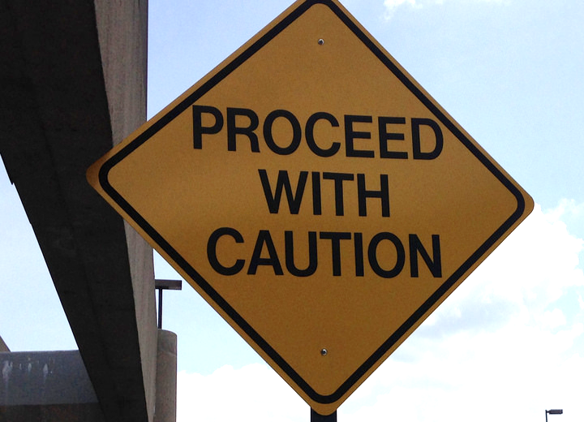
Caveat on Multiple Criteria
Notes:
Picture Source: http://www.henlaw.com/news-events/newsletters/lien-release-proceed-with-caution/
Simply using multiple criteria for gifted and talented identification is not enough. We have to be conscious of how districts are choosing to weigh and combine scores from each criteria to make their placement decisions (McBee, Peters, & Waterman, 2013). If there are minimum requirements for each criteria, for example GPA, standardized achievement test, and cognitive reasoning score, it can cause diverse, advanced learners who perform very well on two of those measures to still fail to be identified due the third measure, despite their strong potential.
Criteria for how we combine multiple data sets has implications for the size of the population identified, the ability distribution of the identified population, and the psychometric performance of the system. Best practice suggests ‘casting a wider net,’ which may include selecting students in one or more areas of their strengths, and identifying a wider range of students with advanced learning needs (McBee, Peters, & Waterman, 2014).
Reference:
McBee, M. T., Peters, S. J., & Waterman, C. (2014). Combining scores in multiple-criteria assessment systems: The impact of combination rule. Gifted Child Quarterly, 58, 69-89. doi: 10.1177/0016986213513794

Slide 29
Identifying and Serving Diverse Highly Capable Students
TO DO… | TO AVOID…
Understand that highly capable students are those who need advanced learning opportunities | Practices that promote the idea that high IQ equates giftedness (e.g. giftedness only exists in the top 5-6% of the population)
Design services that match students’ needs and provide ample opportunities for students to display strengths and talents through curriculum and instruction | Place students in programs without regard for their individualized learning needs
Match assessments with highly capable services (and be sensitive to cultural and linguistic differences) | Use mainly rigid cut-off scores on IQ tests or cognitive ability tests, or use a single test for identification
Use multiple objective criteria to holistically identify students with a need for highly capable services | Use matrices, composite scores, or otherwise put multiple criteria together in ways that limit the recognition of individual student strengths
Offer professional development to various stakeholders (parents, educators, community members) to expand upon their understandings and awareness of the needs of advanced learners | Checklists of bright vs. gifted which reinforces innate views of giftedness (e.g. giftedness is in-born)
Seek and solicit parent involvement as partners and collaborators in their education, send out parent letters in home languages when possible and offer translators for information nights | Not involve parents
Provide opportunities for families and educators to learn from each other and develop inclusive educational communities | Assume that educators must always teach parents about their children
Notes:
Recommendations on Identifying and Serving Diverse Highly Capable Students.
This chart is in pdf form in the readings.

Slide 30
Sample Models in Practice
Project EXCITE
Project Linking Learning
Schoolwide Enrichment Model
U-STARS ~PLUS
Young Scholars Model
Notes:
These are five of the sample models in practice. You will find readings for each of these models. After you read through them, continue on to Activity 4.
For models to succeed in increasing representation of diverse students, the support and participation of teachers, administrators, district coordinators, and parents are required (Horn, 2015; Reed, 2007). Intervention and exposure also needs to happen early.
Notice in each of these models the role of “challenging curriculum and monitoring response as a means to identify and collect evidence of advanced academic potential (Olszewski-Kubilius & Clarenbach, 2012, p. 22).
References/Readings:
Harradine, C. C., Coleman, M. B., & Winn, D. C. (2013). Recognizing academic potential in students of color: Findings of U-STARS~Plus. Gifted Child Quarterly, 58, 23-34. doi:10.1177/0016986213506040
Horn, C. V. (2015). Young Scholars: A talent development model for finding and nurturing potential in underserved populations. Gifted Child Today, 38, 19-31.
Olszewski-Kubilius, P., & Clarenbach, J. (2012). Unlocking emergent talent: Supporting high achievement of low-income, high-ability students. Washington, DC: National Association for Gifted Children.
Olszewski-Kubilius, P. (2006). Addressing the achievement gap between minority and nonminority children: Increasing access and achievement through Project Excite. Gifted Child Today, 29(2), 28-37.
Renzulli, J. S., & Renzulli, S. R. (2010). The schoolwide enrichment model: A focus on student strengths and interests. Gifted Education International, 26, 140-157.

Slide 31
Identification through Curriculum and Instruction
1. Teacher beliefs can change if they see evidence of student engagement and growth through curriculum and instruction
2. Project-based learning provides opportunities for students to display their strengths and talents
3. Documentation may become a key tool for identifying strengths in typically underserved gifted children by providing evidence of process
(Hertzog, 2005)
Notes:
The sample models you read about also highlight the importance of instruction as a method for identifying strengths and talents in diverse students. Students need exposure to instructional techniques and curriculum where they have “opportunities to respond” and develop their talents. These strengths emerge in dynamic, not static, interactions where students are provided multiple ways to respond. Instruction plays a critical role, and all teachers can use instruction for students in talent areas.
1. Teacher beliefs can change if they see evidence of student engagement and growth through changing curriculum and instruction.
2. Project-based learning provides opportunities for students to reveal their strengths and talents.
3. Documentation may become a key tool for identifying strengths in typically underserved populations of gifted children by providing evidence of process.
(Hertzog, 2005)
Reference:
Hertzog, N. B. (2005). Equity and access: Creating general education classrooms responsive to potential. Journal for the Education of the Gifted, 29(2), 213-257.

Slide 32
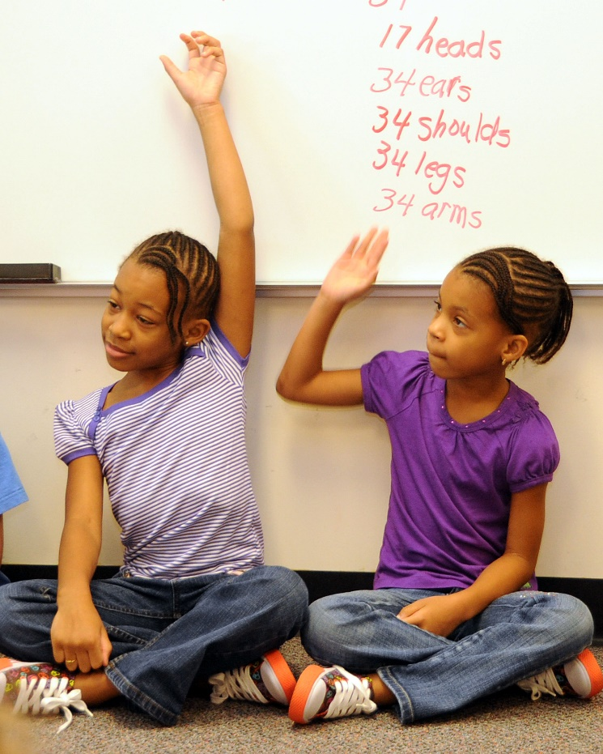
Identification through Curriculum and Instruction
“Educators practice the belief that high level curriculum can be a mechanism for identifying student potential as well as developing it”
(Tomlinson, Ford, Reis, Briggs, and Strickland, 2004)
Notes:
Reference:
Tomlinson, C. A., Ford, D. Y, Reis, S. M., Briggs, C. J., & Strickland, C. A. (2004). In search of the dream: Designing schools and classrooms that work for high potential students from diverse cultural backgrounds. Washington, DC: National Association for Gifted Children.

Slide 33
Assignment 4: Reflection – Role of Curriculum and Instruction
How do these models for identifying and serving diverse groups of students differ from most identification systems in schools?
Describe the role of instruction within the models in helping teachers to identify strengths in all of their students.
How could you personally change your teaching to better see the strengths of students and to serve them appropriately in highly capable services?
What aspects of these models might you find useful in your school or district to provide better access and equity to your highly capable services?

Slide 34
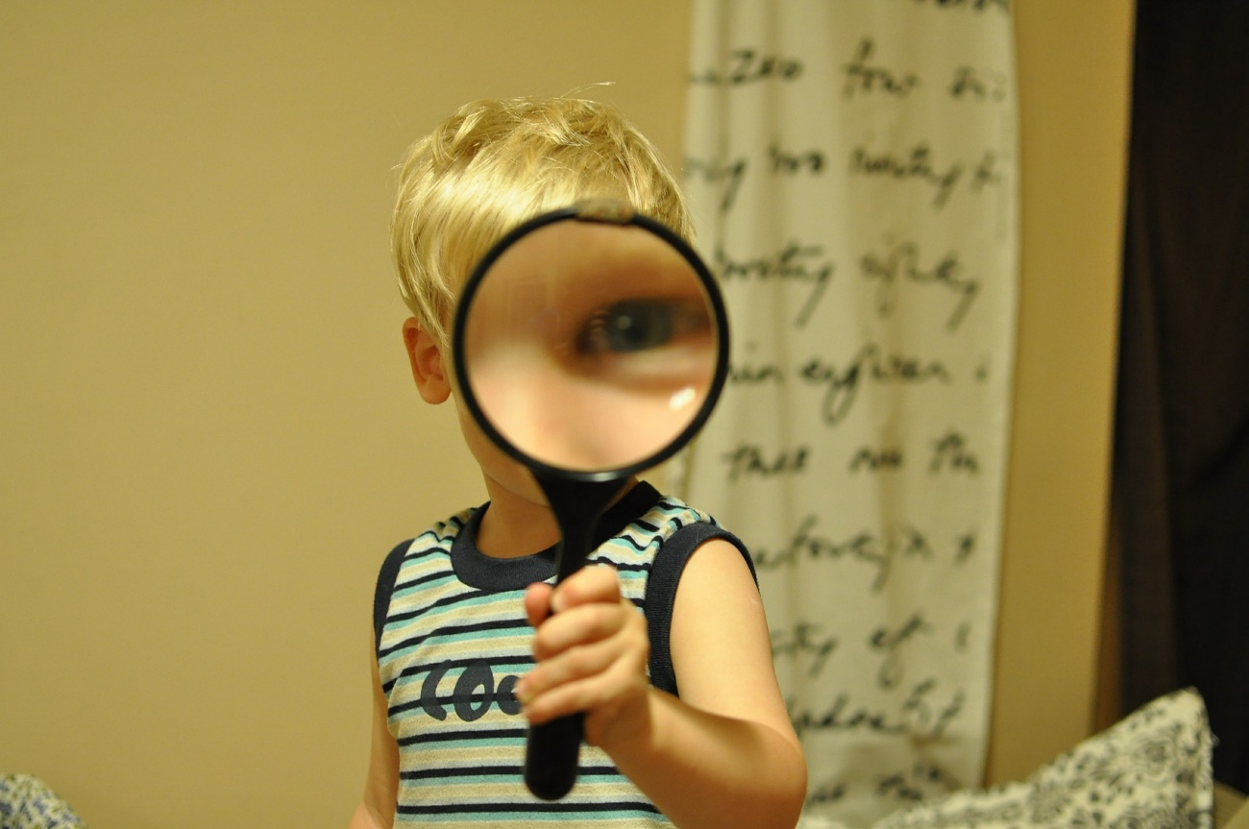
Review
Notes:
In this module, we…
Explored how diversity impacts access and equity to highly capable services
Learned that our preconceptions and implicit beliefs about giftedness and who should be served in highly capable programs could influence the referral and identification process for diverse learners in a negative way.
Were challenged to shift our paradigms from a deficit to a strengths based approach.
Became more familiar with who diverse learners are and how their experiences often shaped their behaviors and performance in schools.
5. Learned evidence-based practices on identifying diverse advanced learners for appropriate highly capable services.
Read and reflected on articles depicting effective models in practice, and considered ways we could implement parts of the model in our own classrooms, schools, and districts
Furthermore, we learned about how instruction was critical for identifying and developing strengths and talents in diverse learners through “opportunities to respond”

Slide 35
Take Action
You are the “change agent” and “advocate” for your students who can bring about positive improvements to your school.
Based on what you have learned from this module, what changes would you implement in your classroom? School? District?
Create a plan that acknowledges the role that diversity plays in identifying and serving highly capable students in your district. Share your plan and/or your ideas with your colleagues, principal and/or district gifted coordinator.
Notes:
You are the “change agent” and “advocate” for your students who can bring about positive improvements to your school.

Slide 36
Credits
Rachel U. Mun (née Chung), Ph.D.
Nancy B. Hertzog, Ph.D.
Jann H. Leppien, Ph.D.
Contact: rachel.chung@uconn.edu
6/1/16

Slide 37
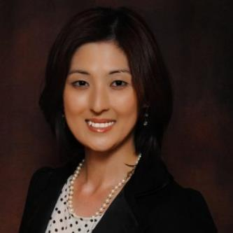
Lead Author Bio
Rachel U. Mun, Ph.D.
Module Writer, Robinson Center for Young Scholars at the University of Washington
Notes:
Picture Source: Rachel Mun
Dr. Rachel U. Mun graduated with a PhD in Education from the University of Washington and conducted research at the Robinson Center for Young Scholars at the University of Washington for three years. She is also currently a Research Scientist with the National Center for Research on Gifted Education (NCRGE) at the University of Connecticut. In fall 2016, she will join the Educational Psychology Faculty (Office for Giftedness, Talent Development, and Creativity) at the University of North Texas as Assistant Professor. For the last four years, Dr. Mun’s research has focused on social and emotional development, immigration, parental influences, career decision-making, and educational access for diverse populations of gifted learners. She is currently involved in multiple federal grant projects related to serving the needs of K-12 underrepresented gifted learners.

