Slide 1
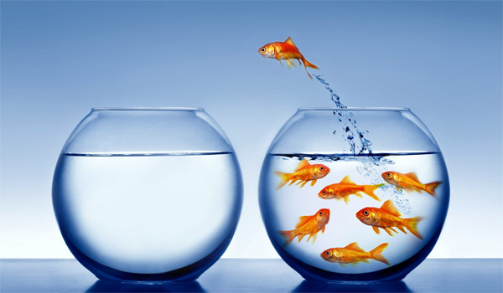
Paradigm Shift
Best practices involve a fair and equitable referral process which requires a paradigm shift. Rather than identifying and remediating weaknesses in students, we shift our focus to identifying strengths and examining giftedness through multiple lenses
Notes:
As discussed, we all have a set of internal beliefs and mindsets that guide our thoughts and behaviors. Unfortunately, diverse learners are often associated with deficits rather than strengths, and thus have a higher chance of being overlooked for advanced academic work and other gifted services. For example, ethnically, culturally and linguistically diverse learners may be associated with lower intelligence due to historical group performance on IQ tests. In particular, low performance of Black students have led some authors to conclude that “Blacks are intellectually inferior” while others argue that the problem rests on the tests themselves and test bias (Ford & Grantham, p. 218). What is likely is that if educators have fixed mindsets about intelligence and believe that Black students are intellectually inferior, then they are not likely to refer them for gifted services.
Likewise, educators may have a certain deficit perception of children with disabilities. Among these perceptions are that children with disabilities do not qualify for gifted services, are unable to keep up in class, need special attention, or lack necessary communication or social skills. These perceptions make teachers less likely to refer twice exceptional children for gifted services, especially those on the autism spectrum.
English learners in particular are the most overlooked group of all diverse students. This is partly due to identification procedures that require advanced English fluency, and partly due to educator beliefs about who would thrive in gifted programs (Mun et al., 2016).
According to a systematic review of the literature conducted by the National Center for Research on Gifted Education, teachers may overlook academic potential in English learners due to “(a) a strong valuing of the English language as a characteristic of giftedness, and (b) a cultural bias in what ‘giftedness’ should look like in children, with a tendency to favor behaviors that reflect dominant culture values such as individualism and verbal expression” explains (Mun et al., 2016, p. 35). In the examples provided, we see how important it is that educators experience a paradigm shift from a deficit framework to a strength-based framework.
References:
Ford, D. Y., & Grantham, T. C. (2003). Providing access for culturally diverse gifted students: From deficit to dynamic thinking. Theory Into Practice, 42, 217-225. doi:10.1207/s15430421tip4203_8
Mun, R. U., Langley, S. D., Ware, S., Siegle, D., Gubbins, J. E., McCoach, D. B.,…Callahan, C. M. (2016). Effective practices for identifying and serving English Learners in gifted education: A systematic review of the literature. Unpublished manuscript.

Slide 2
Changing Deficit Thinking to Dynamic Thinking
Intelligence – Measure using multiple intelligences and areas of strength.
Testing & Assessment – Use multiple criteria and holistic understanding of child.
Communication/Relationships with Diverse Families & Communities – Proactively build relationships with families & communities.
Policies and Practices – Professional development for identification, consider universal screening.
Notes:
Ford and Grantham (2003) discussed how deficit thinking about diverse students “hinders access” to gifted services (p. 217). They list 8 areas of deficit thinking that can be changed into dynamic thinking. Highlighted below are several, with our own recommendations:
Intelligence
Shift from rigid definitions (i.e. IQ-equates-giftedness) to acknowledgement of multiple intelligences and areas of strength
Testing and Assessment
Shift from overreliance on cut-off scores for standardized ability and achievement tests, to exploring multiple objective criteria (and weighting) to understand children more holistically
Communication/relationships with Diverse Families and Communities
Family involvement is crucial in student achievement and particularly for diverse learners who may feel comfortable in the dominant language or culture—shift to proactively and aggressively building relationships and networks with families and communities
Policies and Practices
Teachers can act as gatekeepers—we need to increase professional development in identification and consider universal screening
District policies with gifted enrollment limits—in the state of Washington, access to advanced and accelerated instruction is considered basic education for highly capable. So, does it make sense for example, to limit gifted services to 5-6% of the student population? Can we rationalize limiting education services to students even if they need it?

Slide 3
Funds of Knowledge
Notes:
Strengths-Based Framework
We acknowledge that students bring unique strengths, and we understand that development is dynamic, not static or fixed.
Funds of Knowledge
Recent movements in education literature have emphasized strengths rather than deficits (Aldridge, 2008; Ford & Grantham, 2003). Additionally, the cultural or social capital (i.e., cultural or social) that “disadvantaged” students bring with them has become a focus as well, found (Coleman, 1988; Noguera, 2004). For example, funds of knowledge is a term used “to refer to these historically accumulated and culturally developed bodies of knowledge and skills essential for household or individual functioning and well-being” (Moll, Amanti, Neff, & Gonzalez, 1992, p.133).
Using this framework, diverse advanced learners can be viewed as possessing a wealth of previous knowledge, ability, skill, and fluency in multiple languages.
Teachers’ emphasis on verbal ability may also reflect what they understand are necessary abilities for students to succeed in the school’s gifted programs. If we focus on domain specific giftedness, then students who are still learning English may still have opportunities to flourish in areas such as mathematics. Again, the issue is matching services with an identification process where students’ strengths are emphasized.
References:
Coleman, J. S. (1988). Social capital in the creation of human capital. American Journal of Sociology, 94, S95-S120.
Ford, D. Y., & Grantham, T. C. (2003). Providing access for culturally diverse gifted students: From deficit to dynamic thinking. Theory Into Practice, 42, 217-225. doi:10.1207/s15430421tip4203_8
Moll, L. C., Amanti, C., Neff, D. & Gonzalez, N. (1992). Funds of knowledge for teaching: Using a qualitative approach to connect homes and classrooms. Theory Into Practice, 31, 133-141.
Noguera, P.A. (2004). Social Capital and the Education of Immigrant Students: Categories and Generalizations. Sociology of Education, 77(2), 180-183.

Slide 4
Cultural Competency
Valuing Diversity
Being Culturally Self-Aware
Dynamics of Difference
Knowledge of Students’ Culture
Institutionalizing Cultural Knowledge and Adapting to Diversity
(Diller & Moule, 2005)
Notes:
Changing our mindsets is part of developing cultural competency and becoming culturally responsive educators.
Changing our mindsets is part of developing cultural competency and becoming culturally responsive educators.
The National Education Association says, “Cultural competence is the ability to successfully teach students who come from a culture or cultures other than our own. It entails developing certain personal and interpersonal awareness and sensitivities, understanding certain bodies of cultural knowledge, and mastering a set of skills that, taken together, underlie effective cross-cultural teaching and culturally responsive teaching.” Cultural competency does not develop through a single reading or day worth of training. It takes self-reflection, consistent effort, education, training, and application over time. There are five basic cultural competence skill areas according to Diller and Moule’s, Cultural Competence: A Primer for Educators, Thomson Wadsworth 2005):
Valuing Diversity. Accepting and respecting differences, including different cultural backgrounds and customs, different ways of communicating, and different traditions and values.
Being Culturally Self-Aware. Culture is the sum total of an individual's experiences, knowledge, skills, beliefs, values, and interests. It shapes educators' sense of who they are and where they fit in their family, school, community, and society.
Dynamics of Difference. Knowing what can go wrong in cross-cultural communication and how to respond to these situations.
Knowledge of Students' Culture. Educators must have some base knowledge of their students' culture so that student behaviors can be understood in their proper cultural context.
Institutionalizing Cultural Knowledge and Adapting to Diversity. Culturally competent educators, and the institutions they work in, can take a step further by institutionalizing cultural knowledge. This allows them to adapt to diversity and better serve diverse populations.
References:
Diller, J. V., & Moule, J. (2005). Cultural competence: A primer for educators. Belmont, CA: Thomson/Wadsworth.
National Education Association: http://www.nea.org/tools/30402.htm

Slide 5
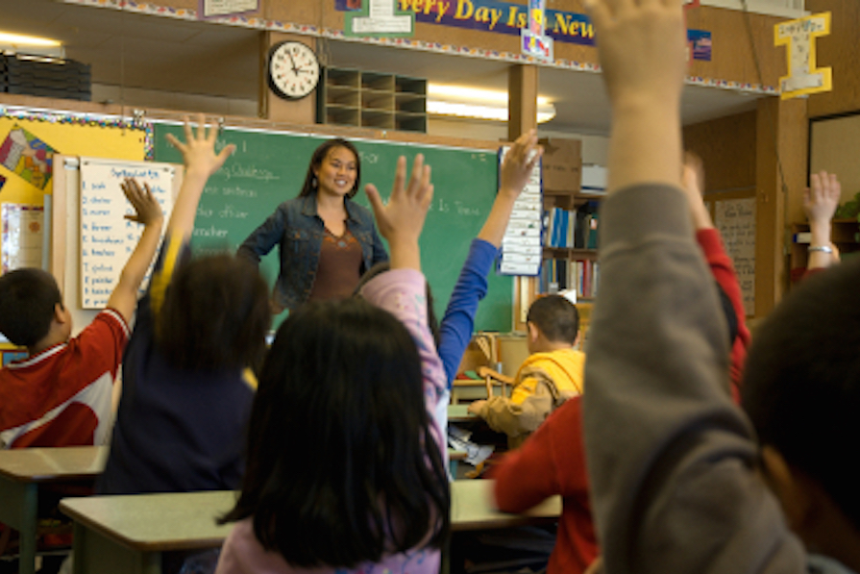
Culturally Responsive Teaching
“…using the cultural knowledge, prior experiences, frames of reference, and performance styles of ethnically diverse students to make learning encounters more relevant to and effective for them” (Gay, 2010, p.31)
Notes:
Culturally responsive teaching uses “the cultural knowledge, prior experiences, frames of reference, and performance styles of ethnically diverse students to make learning encounters more relevant to and effective for them” (Gay, 2010, p.31).
Brown University’s website on culturally responsive teaching references Ladson-Billings, who say,
“Some of the characteristics of culturally responsive teaching are:
Positive perspectives on parents and families,
Communication of high expectations,
Learning within the context of culture,
Student-centered instruction,
Culturally mediated instruction,
Reshaping the curriculum,
Teacher as facilitator.”
References
Gay, G. (2010). Culturally responsive teaching: Theory, research, and practice (2nd ed.). New York, NY: Teachers College Press.
Gay, G. (2013). Teaching to and through cultural diversity. Curriculum Inquiry, 43, 48–70. doi: 10.1111/curi.12002
Ladson-Billings, G. (1994). The dreamkeepers. San Francisco: Jossey-Bass Publishing Co.
Brown website: https://www.brown.edu/academics/education-alliance/teaching-diverse-learners/strategies-0/culturally-responsive-teaching-0

Slide 6
Terms and Definitions
Federal Definition
State Definitions
Notes:
The federal government defines gifted students as “Students, children, or youth who give evidence of high achievement capability in areas such as intellectual, creative, artistic, or leadership capacity, or in specific academic fields, and who need services and activities not ordinarily provided by the school in order to fully develop those capabilities” (No Child Left Behind, 2002). However, there is no federal mandate to identify or provide services for gifted learners (Castellano & Matthews, 2014). Instead, it is up to the states to do so, said the Council of State Directors of Programs for the Gifted and National Association for Gifted Children, 2013). This means that how students are defined, identified, and served may vary by state, district, and school depending on the legislative policies of each state (Stephens, 2008).
References
Castellano, J. A., & Matthews, M. M. (2014). Legal issues in gifted education. In J. P. Bakken, F. E. Obiakor, & A. F. Rotatori (Eds.), Gifted education: Current perspectives and issues (pp. 1-19). UK: Emerald Group Publishing.
Council of State Directors of Programs for the Gifted and National Association for Gifted Children. (2013). State of the states in gifted education: National policy and practice data [CD-ROM]. Washington, DC: National Association for Gifted Children.
No Child Left Behind (NCLB) Act of 2001, Pub. L. No. 107-110, § 115, Stat. 1425 (2002).
Stephens, K. R. (2008). Federal and State Response to the Gifted and Talented. Journal of Applied School Psychology, 27(4), 306-318. DOI: 10.1080/15377903.2011.615823

Slide 7
Washington State Definition: Students Who are Highly Capable
Highly capable students are students who perform or show potential for performing at significantly advanced academic levels when compared with others of their age, experiences, or environments. Outstanding abilities are seen within students’ general intellectual aptitudes, specific academic abilities, and/or creative productivities within a specific domain. These students are present not only in the general populace, but are present within all protected classes according to chapters 28A.640 and 28A.642 RCW.
WAC 392-170-035
Notes:
In Washington State, recent legislative changes to the Washington Administrative Codes (WACs) have made clear that for gifted students, “access to accelerated learning and enhanced instruction is considered access to a basic education.” (WAC 392-170-012). In other words, students identified as gifted or highly capable require accelerated or specialized instruction to learn and grow. The State recognizes that highly capable students “perform or show potential for performing” at more advanced academic levels compared to their peers and that these students are present in all populations including protected classes (WAC 392-170-012). The WACs also stress the importance of using “multiple objective criteria” for identification purposes and that “There is NO SINGLE Prescribed method for identification” (WAC 392-170-055). While the WACs provide guidelines, the individual districts decide how to implement their gifted programs and what multiple objective criteria to utilize.
Readings:
A Primer on the Wacs (Cheatsheet)
Akin, C., Chung, R. U., & Hertzog, N. B. (Eds.). (2015). Highly Capable Program Handbook. Retrieved from https://robinsoncenter.uw.edu/2015/06/new-educators-highly-capable-program-handbook/

Slide 8
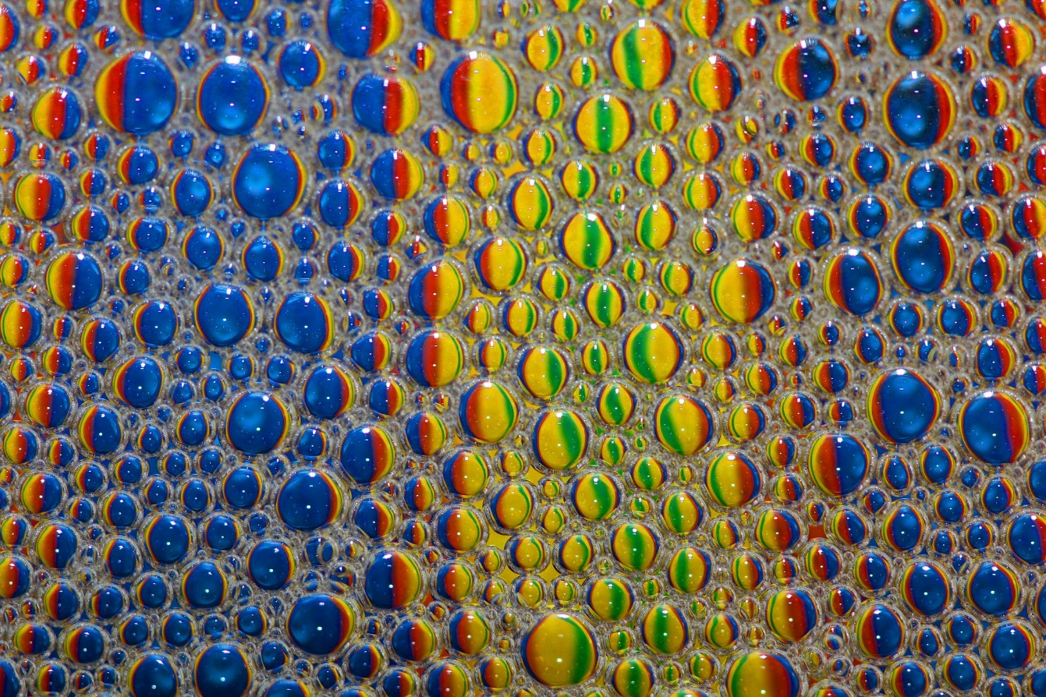
Irrelevant: Bright Vs Gifted
Notes:
You may be familiar with the bright vs gifted chart, which appeared in a 1989 article in Challenge Magazine by Janice Szabos. If not, the chart is a list of descriptors differentiating between a bright child and a gifted learner.
The question is not about whether a child is bright or gifted. The question we should ask is: Who needs advanced learning, bright or gifted? [Pause] If you said both, that is correct!
Challenge and growth in learning should be the goal. The distinction of whether or not a person is gifted vs. “just bright” is not relevant in the field of K-12 education (Peters, 2014). Ultimately, we are concerned with “optimal match.” Instruction, curriculum, and education setting should represent advanced learners needs, (Robinson & Robinson, 1982; VanTassel-Baska, 2014).
References:
Peters, S. J. (2014, July 10). The bright vs. gifted comparison: A distraction from what matters. Creativity Post. Retrieved from http://www.creativitypost.com/education/the_bright_vs._gifted_comparison_a_distraction_from_what_matters.
Robinson, N. M., & Robinson, H. B. (1982). The optimal match: Devising the best compromise for the highly gifted student. In D. Feldman (Ed.), New directions for child development: Developmental approaches to giftedness and creativity (pp. 79-94). San Francisco, CA: Jossey-Bass.
Szabos, J. (1989). Bright child, gifted learner. Challenge, 34. Good Apple.
http://www.ode.state.or.us/teachlearn/specialty/tag/r5brightchild.pdf (chart)
VanTassel-Baska, J. (2014). Matching curriculum, instruction, and assessment for the gifted. In J. A. Plucker & C. M. Callahan (Eds.), Critical issues and practices in gifted education (pp. 377-385). Waco, TX: Prufrock Press.

Slide 9
Multicultural Conceptions of Giftedness
Notes:
“Different cultures have different conceptions of what it means to be gifted. But in identifying children as gifted, we often use only our own conception, ignoring the cultural context in which the children grew up. Such identification is inadequate and fails to do justice to the richness of the world's cultures.” (Sternberg, 2006)
For Taiwanese Chinese, their conception of intelligence may include interpersonal and intrapersonal skills or self-understanding (Sternberg, 2006). Achievement motivation in East Asian contexts reveal an emphasis of effort over ability as compared to Western contexts, which typically focus more on the individual’s ability. In Korea, there is a saying sugohaseyo, which translates to keep working hard. It is often used in educational and work contexts. Encapsulated in this phrase is the idea that one can always work harder (Chung, 2015).
In Australia and New Zealand, there is a strong emphasis on egalitarianism, which stems from a history of settlement by “English freemen and convicts.” This has created a “culture of resentment towards successful individuals” and high achievers or “tall poppies.” These high achievers are then “’cut down to size’ by those who are less successful in order to ‘normalize them.’” (O’Neill, Calder, & Allen, 2014).
In Black American culture, “Acting White is a term frequently used by Black students in a derogatory manner to point out and attack another Black students’ connection with perceived White students’ values, norms, beliefs, attitudes, styles, and preferences” (p. 178) Black students were deemed ‘acting white’ if they obtained good grades, were deemed smart, or participated in advanced and honors courses (Grantham & Biddle, 2014).
Emphasize giftedness as social construct (Borland, 2005).
References/Readings:
Borland, J. H. (2005). Gifted education without gifted children: The case for no conception of giftedness. In R. J. Sternberg & J. E. Davidson (Eds.), Conceptions of giftedness (pp. 1-19). New York, NY: Cambridge University Press.
Chung, R. U. (2015). Parental expectations for Asian American men who entered college early: Influences on their academic, career, and interpersonal decision-making (Unpublished doctoral dissertation). University of Washington, Seattle.
Grantham, T. C., & Biddle, W. H. (2014). From bystander to upstander teacher for gifted black students accused of acting white. Gifted Child Today, 37 (3), 178-187.
O’Neill, M., Calder, A., & Allen, B. (2014). Tall poppies: Bullying behaviors faced by Australian high-performance school-age athletes. Journal of School Violence, 13, 210-227.
Sternberg (2007). Cultural concepts of giftedness. Roeper Review, 29, 160-165.

Slide 10
Assignment 2: Reflection – Conceptions of Giftedness
Reflect on your personal conception of who would benefit from highly capable services. Take a minute to write or visually represent this.
How is the personal conception challenged by what you have just learned about the impact of diversity on conceptions of giftedness?
How does your program serve students “who perform” and students who “show potential?”

