Slide 1
Access and Equity: Module 2
A Deep Dive into the Uses of Multiple Criteria
Revised August 8, 2016
Notes:
Welcome to Module 2: A Deep Dive into the Uses of Multiple Criteria. What should we consider when identifying children for highly capable programs and services? This is one of the most difficult questions to answer in the gifted education field. The research and standards regarding best practices include “the use of multiple criteria” when designing procedures and processes for the identification and selection of students who may benefit from highly capable services. In this session, we will unpack what is meant by “multiple criteria.” Not only, will we understand what multiple criteria is, but also how to use the many and varied sources that are collected to determine a student’s educational needs.

Slide 2
Module Overview and Learning Outcomes
Overview:
This module introduces participants to the importance of using multiple criteria for identifying students’ strengths and learning needs to design services that match their identification. Participants explore various instruments, tools, and procedures that optimize the match between identification and services. Most importantly, this module emphasizes the need to collect, document, and use data to guide decision making for access and equity to highly capable services.
Outcomes:
Upon completion of this module, participants will be able to use multiple criteria during the identification process, which leads to appropriately designed highly capable services that address students’ learning needs.
Notes:
This module highlights the importance of using multiple criteria and assessment sources by which students can enter the identification pool for consideration at various points in their school careers. By using multiple pathways in the identification process, a more holistic view of students’ gifts and talents can be brought to the attention of the Multidisciplinary Selection Committee, who will also make suggestions as to the types of services that would best serve students identified as highly capable. Program personnel should consider several sources of data in determining who will receive further consideration since this provides a more comprehensive profile of a student’s strengths. It is also important to recognize that talent can be latent, which suggests that a child who may have not exhibited gifted behaviors in second grade, for example, may emerge as very talented in fourth grade and should merit consideration for placement. Exemplary practices in identification also call for ongoing identification by designing a means through which students whose talents emerge after the first screening and identification take place can be given consideration for receiving highly capable services at another point in a student’s academic career.

Slide 3
Alignment with NAGC Standards
This module aligns with the following NAGC-CEC Teacher Preparation Standards in Gifted Education- Standard 4: Assessment (NAGC, 2013).
Professionals must be knowledgeable about how multiple methods of assessment and data sources guide effective educational decisions about the identification and services for highly capable students.
Professionals should become knowledgeable about measurement principles and practices to interpret results to guide educational decisions for individuals identified as highly capable.
Professionals collaborate with colleagues and families in using multiple types of assessment information to make identification and learning progress decisions and to minimize bias and assessment decision-making.
Multiple criteria assumes a gathering of data from multiple perspectives which provides a more holistic view about the types of services that would best serve students identified as highly capable.
Notes:
This module aligns with the following NAGC-CEC Teacher Preparation Standards in Gifted Education-Standard 4: Assessment (NAGC, 2013).
Professionals must be knowledgeable about how multiple methods of assessment guide effective educational decisions about the identification and services for highly capable students.
Professionals should become knowledgeable about measurement principles and practices to interpret results that guide educational decisions for individuals identified as highly capable.
Professionals collaborate with colleagues and families in using multiple types of assessment information to make identification and learning program decisions and to minimize bias and assessment decision-making.
Multiple criteria assumes a gathering of data from multiple perspectives which provides a more holistic view about the types of services that would best serve students identified as highly capable.

Slide 4
Module Objectives
Articulate the relationship between multiple criteria and equity and access to highly capable services.
Examine critically current district methods and practices used to identify strengths of students for highly capable services
Explain how multiple criteria should inform procedures for screening and identifying students for highly capable services.
Describe the types and purposes of assessment tools used to make appropriate decisions about the educational needs of students.
Use multiple assessment tools for identifying students’ strengths, interests, and educational needs appropriately with knowledge of the limitations and intent of the various types of instruments.
Notes:
These are the major objectives for this module:
Articulate the relationship between multiple criteria and equity and access for highly capable services.
Examine current district methods and practices used to identify strengths of students for highly capable services.
Explain how multiple criteria should inform procedures for screening and identifying students for highly capable services.
Describe the types and purposes of assessment tools used to make appropriate decisions about the educational needs of students.
Use multiple assessment tools for identifying students’ strengths, interests, and educational needs appropriately and with knowledge of the limitations and intent of the various types of instruments.

Slide 5
Access and Equity
Notes:
Callahan, Renzulli, Delcourt, & Hertberg-Davis (2013) state, “A comprehensive and defensible identification plan will recognize developmental differences in children” (p. 85).. The use of multiple criteria provides us with several pathways to bring student strengths and talents to our attention. Far too often, final decisions about the identification of a student for highly capable programs comes down to how well a student has performed on only one measurement tool, rather than the consideration of several sources of data to determine who needs further evaluation or advanced learning opportunities. These selections fail to use multiple sources of data in their final decision, which results in a bias in the identification process.
There are two main reasons to use multiple criteria: The first– No ONE instrument, measure, or work sample can demonstrate accurately the learning needs of an individual. The second reason relates to access and equity --- using only standardized test scores, on either aptitude or achievement tests, create biased access to programs. Research from the National Center for Research on Gifted Education indicates that if you’re poor, speak a native language other than English , or are a person of color, you are highly unlikely to enter into a gifted program. This demonstrates the inequities in the identification systems that have historically dominated the U.S. education system.
References:
Callahan, C. M., Renzulli, J. S., Delcourt, M. A. B., & Hertberg-Davis, H. L. (2013). Considerations for identification of gifted and talented students: An introduction to identification. In C. M. Callahan & H. L. Hertberg-Davis (Eds.), Fundamentals of gifted education: Considering multiple perspectives (pp. 83-91). New York: Routledge, Taylor and Francis Group.

Slide 6
Washington State Definition
Highly capable students are students who perform or show potential for performing at significantly advanced academic levels when compared with others of their age, experiences, or environments. Outstanding abilities are seen within students' general intellectual aptitudes, specific academic abilities, and/or creative productivities within a specific domain.
WAC 392-170-035
Notes:
As a reminder, the Washington State definition of highly capable students includes both students who perform or show potential for performance at significantly advanced academic levels. Inherent in the definition, are the areas in which students may show their strengths: intellectual aptitudes, specific academic abilities, and creative productivities. These areas also point to varied data sources that can be used to indicate students’ strengths.

Slide 7
055 – Assessment Process for Selection as Highly Capable Student.
Students nominated for selection as a highly capable student, unless eliminated through screening as provided in WAC 392-170-045, shall be assessed by qualified district personnel;
Districts shall use multiple objective criteria for identification of students who are among the most highly capable. There is no single prescribed method for identification of students among the most highly capable; and
Districts shall have a clearly defined and written assessment process.
Notes:
The actual language in the WAC says, “Districts shall use multiple objective criteria for identification of students who are among the most highly capable.” Notice the word “objective” – How do we ensure that a teacher’s referral is objective data and not a subjective evaluation of a student? How can we be sure that one instrument does not bias who will be served in a highly capable program? These and other questions must be explored in order to achieve our goal of providing access and equity for students who require advanced learning services. As a result of viewing this module, we hope you will be able to critically evaluate your current identification practices and work to improve your district’s plan for identifying students for advanced learning services.

Slide 8
Key Questions
Notes:
Picture Source: https://pixabay.com/en/question-question-mark-request-1422602/
These common questions need to be addressed by district personnel before designing their identification process.
What constitutes the multiple criteria you will use to guide your decision making during the identification processes?
Why do you look at different pieces of evidence? How might this information help you to build student profiles to support the educational decisions you make to guide student learning?
Is your district struggling with the mandate to use multiple criteria in your screening, assessment, and identification decisions? If so, what changes can be made?
Are there wrong and right ways to use multiple criteria for selection of students for services in highly capable programs?
Can cut-off scores be used for screening students as sole indicators for further evaluation?
Can districts use three out of four data points to identify students if none of the data points include an ability test?

Slide 9
Key Understandings about Identification
Notes:
Before we continue our discussion about the use of multiple criteria, it is important to review the key understandings about identification:
The purpose of identifying students as highly capable is to match student strengths to student services that support them as continuous learners.
Most highly capable students have learning needs for challenge and continued growth.
Identification is about identifying students for services and not about labeling a child. We are identifying students for the services they need based on assessment data. The emphasis should be placed on the educational continuum of services K-12 that particular students will require that exceed the instructional levels of their peers.
Students’ educational needs often change and services will continually need to be reviewed to ensure a proper match between the services and their academic and social needs.
Callahan, Renzulli, Delcourt, & Hertberg-Davis (2013) bring to our attention that, traditionally, the process of identification has focused on selecting students and labeling them gifted. However, a better approach would be to document specific student strengths by preparing student profiles that direct our efforts toward designing appropriately matched student services aligned to these strengths.
References:
Callahan, C. M., Renzulli, J. S., Delcourt, M. A. B., & Hertberg-Davis, H. L. (2013). Considerations for identification of gifted and talented students: An introduction to identification. In C. M. Callahan & H. L. Hertberg-Davis (Eds.), Fundamentals of gifted education: Considering multiple perspectives (pp. 83-91). New York: Routledge, Taylor and Francis Group.
Other Resources:
Delcourt, M. A. B. (2007). The effects of programming arrangements on the achievement and self-concept of gifted elementary school students. Gifted Child Quarterly, 54, 350-381.
Field, G. B. (2009). The effects of the use of Renzulli Learning on student achievement in reading comprehension, reading fluency, social studies, and science: An investigation of technology and learning in grades 3-8. International Journal of Emerging Technologies in Learning, 4, 29-39.
Frasier, M. M., Garcia, J. H., & Passow, A. H. (1995). A review of assessment issues in gifted education and their implications for identifying gifted minority students. (Research Monograph 95204). Storrs: The National Research Center on the Gifted and Talented, University of Connecticut.
Gardner, H. (1983). Frames of mind: The theories of multiple intelligences. New York: Basic Books.
Renzulli, J. S., & Reis, S. M. (1997). The Schoolwide Enrichment Model: A how-to guide for educational excellence (2nd ed). Waco, TX: Prufrock Press.
Renzullii, J. S., Reis, S. M. (2007). A technology based program that matches enrichment resources with student strengths. International Journal of Emerging Technologies in Learning, 2. Retrieved July 21, 2016 from http://online-journals.org/ijet/article/viewArticle/126.
Sternberg, R. J. (1985). Beyond IQ: A triarchic theory of human intelligence. New York: Cambridge University Press.
Winner, E. (1996). Gifted children: Myths and realities. New York: Basic Books.

Slide 10
WAC Addressing Identification Procedures (28A.185.030 )
Referrals based upon data from teachers, other staff, parents, students, and members of the community. Assessment shall be based upon a review of each student's capability as shown by multiple criteria intended to reveal, from a wide variety of sources and data, each student's unique needs and capabilities. Selection shall be made by a broadly-based committee of professionals, after consideration of the results of the multiple criteria assessment.
Notes:
In this section of the WAC, we see that the intent of the law is to include multiple ways of assessing student strengths and multiple perspectives. The decision to identify includes a committee of professionals who will serve on the Multidisciplinary Selection Committee. The purpose of a team is to examine the body of evidence that decides who needs highly capable services. The evidence must include the use of multiple types of measurement and data sources.

Slide 11
Multidisciplinary Committee
This committee will consist of:
A special teacher
A psychologist
A certified coordinator/administrator
Other professionals deemed necessary by the district
The committee will often make the following determinations:
Parent notification – testing and selection
Identification of students
Inform families of the types of services
Parent notification – results of data and review
Determine avenue of twice-exceptional students
Notes:
This committee shall consist of:
A special teacher: By definition this is a teacher who has training, experience, advanced skills, and knowledge in the education of highly capable students. Areas of competency should include: identification procedures, program design and delivery, instructional practices, student assessment, and program evaluation. If such teacher is not available, then a classroom teacher shall be appointed;
A psychologist or other qualified practitioner with training to interpret cognitive and achievement test results;
A certified coordinator/administrator with responsibility for the supervision of the district’s program for highly capable students; and
Such additional professionals, if any, the district deems desirable.
It is often the work of the Multidisciplinary Selection Committee to examine the body of evidence and may make the following determinations:
Notify parents of testing and selection of students for program services;
Identify students to receive highly capable services aligned to students’ profile of strengths and interests;
Inform families about the types of services their child(ren) will receive as a result of being identified for highly capable services;
Determine that the data collected do not support the identification of a particular student at this given time and notify parents; and
Determine if a student should be referred for further assessment if a student is twice-exceptional.

Slide 12
Multiple – Many
Criteria – multiple instruments and data points
Input Sources – teachers, parents, community, and students.
Decision Team – multiple roles, knowledgeable in different areas
Notes:
So, when we break down the word multiple, we are not only talking about multiple criteria, but we are also identifying multiple sources of input and seeking input from multiple decision-makers. These ideas help to make our identification processes more responsive and pliable to multiple perspectives of giftedness as viewed by the data collected, numerous individuals who may have knowledge about a particular child’s advanced talents and skills, and through the diverse perspectives of those who must collaborate with each other as student profiles of talent are revealed and services are aligned to serve and respect the academic and social needs of these students.

Slide 13
Equal Access Begins with Referral
During the identification process referrals are solicited from a variety of sources. Referrals are based upon data from teachers, other staff, parents, students, and members of the community.
The purpose of this statement is to insure all students have the opportunity to be referred.
The open process provides more access for traditionally underrepresented students
A variety of referrals helps to highlight individual students’ talent
Professional development should be provided to educators about the referral process.
Schools should have a large pool of applicants during this phase.
Notes:
The law requires districts to include a variety of sources for referrals and notification announcements to inform the public about the policies and procedures used in the identification process to identify highly capable students, which include:
Annual public notification of parents and students shall be made before any major identification activity.
The notice shall be published or announced in multiple ways in appropriate languages to each community in school and district publications or other media, with circulation adequate to notify parents and students throughout the district.
During the Referral Phase of the identification process, referrals are solicited from a variety of sources. Referrals are based upon data from teachers, other staff, parents, students, and members of the community. (28A.185.030)
The purpose of this statement is to ensure that all students who might have potential in related areas of giftedness defined by the district are referred.
This open-process of referrals better ensures that we pay close attention to students who traditionally have been underrepresented in gifted programs. These groups may include students with disabilities and other learning challenges, who are culturally and linguistically diverse, or who experience economic challenges that prevent the opportunity to access high quality educational experiences.
Referrals from a variety of sources will provide the means through which a student’s talent will be brought to the attention of the identification and selection teams.
Professional development should be provided to educators about this referral process. Research suggests that teachers identify more children when they are provided with training in understanding the academic and social needs of highly capable students (Gear, 1978).
At the end of the referral phase, schools should have a large pool of applicants, who will proceed to the second phase of identification, which is screening.

Slide 14
Equal Access in Assessment
Assessment shall be based upon a review of each student's capability as shown by multiple criteria intended to reveal, from a wide variety of sources and data, each student's unique needs and capabilities. (28A.185.030)
During the Assessment Phase, specific measurement tools and non-standardized sources of data are used to identify student strengths. Using a variety of data, the profiles of student strengths are revealed to indicate the types of services required.
Notes:
By using varied sources of data, we are able to gather important information about multiple dimensions of a student’s performance and potential. The criteria for screening and identification must be carefully considered to ensure development of student profiles that reflect the best possible picture of student talent and to guide the best match with educational programming.

Slide 15
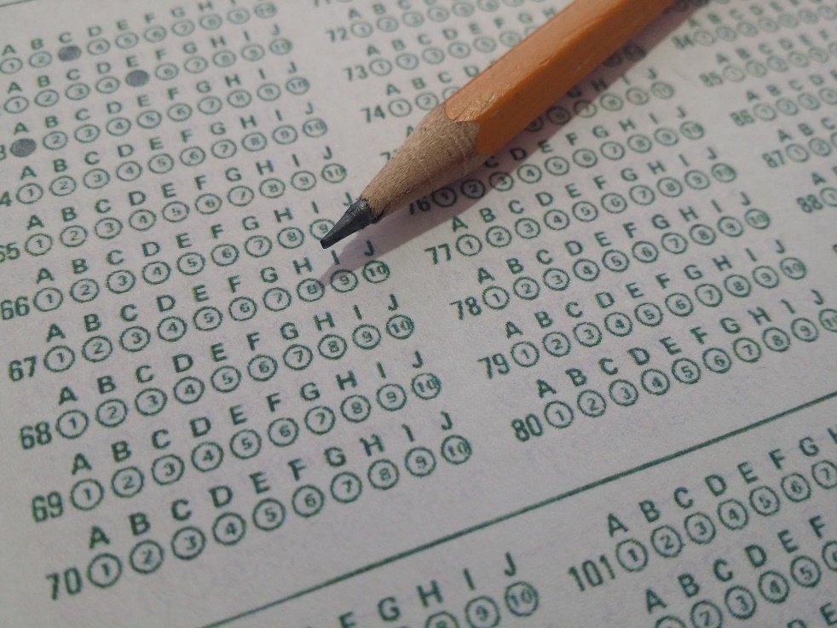
Standardized Instruments
Achievement Tests
Aptitude Tests
Intelligence Tests
Teacher Rating Scales
Creativity Tests
Notes:
Picture Source: http://worldartsme.com/
Educators should select and use multiple assessments that measure diverse abilities, talents, and strengths, based on current theories, models, and research. Multiple criteria help to build a body of evidence that meets the criteria for student selection in highly capable programs, and helps to build student profiles of strengths and interests from which services can be determined.
Most districts use some form of standardized instrument to assess their students’ abilities. There are many standardized instruments schools may use as data points during the assessment phase of the identification process. All instruments should be used as they were designed to be used.
References:
Assouline, S. G., Nicpon, M. F., & Whiteman, C. (2010). Cognitive and psychosocial characteristics of gifted students with written language disability. Gifted Child Quarterly, 54, 102-115.
Callahan, C. M. (2005). Identifying gifted students from underrepresented populations. Theory into Practice, 44, 98-104.
Colangelo, N., Assouline, S. G., Marron, M. A., Castellano, J. A., Clinkenbeard, P. R., Rogers, K., et al. (2010). Guidelines for developing an academic acceleration policy. Journal of Advanced Academics, 21, 180-203.
Kalbfleisch, M. L., & Iguchi, C. M. (2008). Twice-exceptional learners. In J. A. Plucker & C. M. Callahan (Eds.), Critical issues and practices in gifted education: What the research says (pp. 707-719). Waco, TX: Prufrock Press.
Robinson, N. M. (2005). In defense of a psychometric approach to the definition of academic giftedness: A conservative view from a die-hard liberal. In R. J. Sternberg, & J. E. Davidson (Eds.), Conceptions of giftedness (2nd ed., pp. 417-435). Boston: Cambridge University Press.
VanTassel-Baska, J., Feng, A. X., & de Brux, E. (2007). A study of identification and achievement profiles of performance task-identified gifted students over 6 years. Journal for the Education of the Gifted, 31, 7-34.

Slide 16
Different Assessment Categories
Achievement Tests – measure knowledge or proficiency
Aptitude Tests – predict future performance
Intelligence Tests – measure intelligence trait
Teacher Rating Scales – teacher provides judgment
Creativity Tests – measure creative abilities
Notes:
Several categories of assessment data are often gathered to identify the strengths and readiness levels of students for certain types of services that the Highly Capable Program will provide. These may include:
Achievement Tests—Measure knowledge of or proficiency in something learned or taught about in a content area (i.e., math). Commonly administered achievement tests include: Iowa Test of Basic Skills (ITBS); California Achievement Test (CAT); and the Stanford Achievement Test. The ACT Assessment used for college entrance falls under the category of an achievement test.
Aptitude Tests—Predict future performance in a particular domain. Examples of such tests include: Cognitive Abilities Test CogAT 7 and the CogAT Screening Form 7, OLSAT 8, SAT Reasoning Test (SAT); and the Differential Aptitude Test (DAT).
Intelligence Tests—Measure some of the structures and processes underlying intelligence as an internal trait.
These tests sample behavior already learned in an attempt to predict future learning. The Wechsler Intelligence Scale for Children, Fifth Edition (WISC-V); the Stanford-Binet Intelligence Scales-Fifth Edition (SB-V); and the Naglieri Nonverbal Ability Test (NNAT2) are examples of IQ measures.
Teacher Rating Scales–Teacher rating or judgment scales provide additional and different information about the characteristics and behaviors we associate with giftedness. Experts in the field of gifted education have long recommended using teacher judgment measures among the multiple sources of information for screening and identifying students for gifted education services.
Tests of Creative Abilities- These tests purport to measure students’ creative abilities.
As views on intelligence and giftedness have broadened beyond IQ, a new paradigm for identifying a diverse range of students appears appropriate and necessary (Callahan, 2005; VanTassel-Baska, Feng, & de Brux, 2007). Researchers have recommended the use of multiple criteria including the use of portfolios, scores from traditional assessments, creativity measures, and authentic classroom assessments that are also valid and reliable. However, it must be noted that traditional assessment tests have been shown to be effective when trying to: (1) estimate a student’s readiness for the next level of instruction or services provided to identified students or for students whose ability and performance levels exceed their peers; and (2) make decisions or design accelerative interventions for students who benefit from more advanced interventions (Colangelo, et. al., 2010; Robinson, 2005). Other researchers have argued that ability and achievement tests may be useful in the identification of twice-exceptional learners where discrepancies between and within achievement and ability scores are seen, (Assouline, Nicpon, & Whiteman, 2010; Kalbfleisch & Iguchi, 2008).

Slide 17
Other Sources of Information
Anecdotal Records
Behavior Checklists
Case Study Approach
Curriculum-Based Assessments
Grades
Interviews
Leadership
Performance-Based Activities or Assessment
Products
Referral Forms
Notes:
There are other sources of data that provide additional information about the learning needs of students. No one source is necessarily more important than another unless it is used to design a specific academic or behavioral intervention. For example, if the school is setting up a student government council, a leadership checklist or scale may be used to identify students that they wish to encourage to participate. Another example might be a student who has a strong interest in a topic and has completed an investigative project and presented it to the class, this student may be recognized as needing more opportunities to pursue strong interests in more depth and at higher levels of involvement. Teachers often use curriculum-based assessments to measure student growth. Teachers who note that students have mastered the grade-level curriculum might or may use this data to refer students for further assessment or to enhance our knowledge about the academic profiles of particular students.
These sources are not restricted to a school setting. Talent may arise through involvement in extra-curricular or community activities that reveal deep interests, strengths, and engagement that are also tied to deeper levels of knowledge in one or more specific fields of study. Securing referrals from parents, community leaders, religious leaders, etc. help us to identify students’ interests and build a more comprehensive portfolio should guide decisions about how to support, challenge, and accelerate student growth.

Slide 18
Stop and Pause: Read
Select and read the articles posted on our website that address issues and concerns about the identification of highly capable students. Many of the articles address assessment concerns that surface as schools develop their procedures and criteria for the selection of students.
You might consider assigning these articles to various group members on your team to highlight the phrases or new insights that made them stop and pause in their thinking. This often helps us identify ideas that are worth considering or think about when reviewing our current identification procedures and practices.
Notes:
Need a list of the articles that are related to these topics.

Slide 19
Activity 1: Reflection – Multiple Sources of Data
Reflect upon the sources of data you use in your district to identify the strengths of your students.
What data do your sources reveal about your students?
Do the sources provide different perspectives on them?
How do these sources inform your thinking about instructional and learning needs?

Slide 20
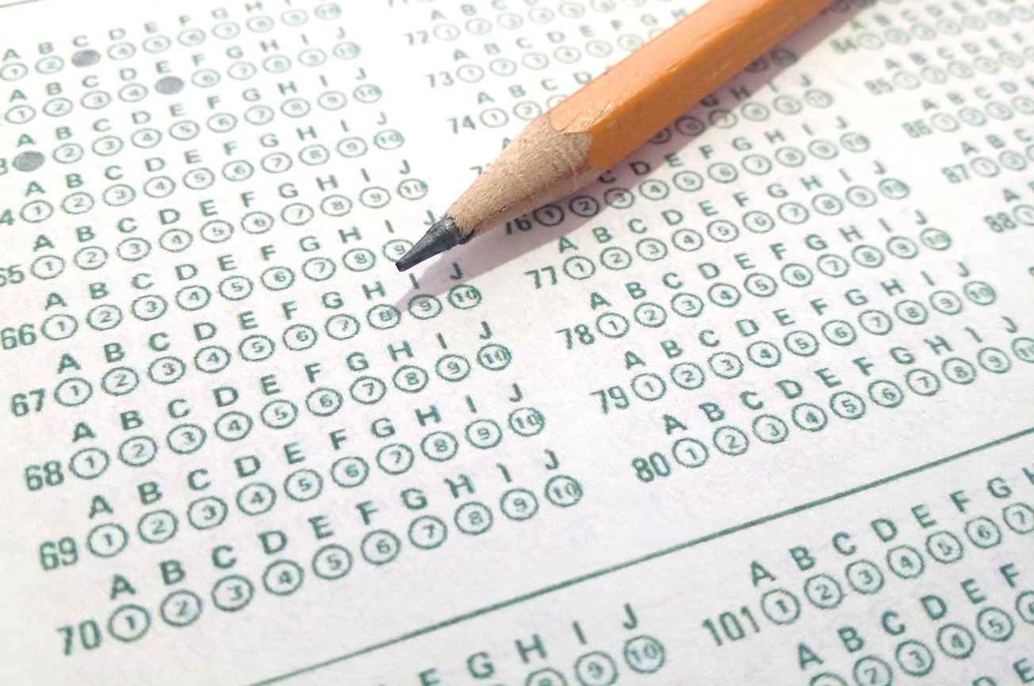
What to Look for in a Test
What to Look for in a Test
Notes:
To better understand standardized instruments used during the identification process, we should examine the psychometrics behind any instrument selected. Each instrument has psychometric properties such as reliability and validity. Published instruments have technical manuals with directions for administration and appropriate use. The manual also includes information about reliability, validity, standard errors of measurement, and norming samples. For more information and reviews of published instruments, you may wish to consult the Mental Measurements Yearbook and Test Reviews available from the Buros Center for Testing. In this video, we’ll focus on the essential properties of standardized instruments.

Slide 21
Testing and Measurements Properties
Validity
“Does this test measure what it says?”
Reliability
Consistent results
Standard Error of Measurement (SEM)
Variation in test scores for the same student
If a student’s score is within the SEM of the cut score, you cannot definitively say whether that student is actually above or below that cut score.
Notes:
Validity, reliability, and standard error of measurement are the criteria that define high quality measurement tools. Within each testing manual you will find information about these properties, and how the tests were normed.
Validity asks the question, “Does this test measure what it says it does”? If it doesn’t, then results will not be meaningful. Validity is a matter of degree. The more valid an instrument is, the more you can trust the results to provide you with information about the child based on what it measures.
Reliability means that the results should be consistent every time the test is taken. In other words, are the scores stable over time? Reliability coefficient range from 0-1. The higher the reliability coefficient score, the more reliable the instrument.
When we administer a test and make decisions about a student’s educational program, we want to assume that the score will be reliable. It is also important to realize that rating scales and other instruments used in the identification process should have interrater reliability. This means that when two raters are scoring a student’s work, their scores yield similar results. This ensures results are not affected by rater bias, regardless of a student’s performance level (Callahan, Renzulli, Delcourt, & Hertbert-Davis, 2013).
Questions that might be considered when selecting a reliable instrument:
Stability: Are the test results consistent over time?
Equivalence: Are the test results similar with different forms of the test?
Internal Consistency: Are the items in the test homogeneous?
Reliability Coefficient Range: Is the reliability coefficient high enough? In general, it should be .80 or higher
The Standard Error of Measurement or SEM is the estimate of the amount of variation in a student’s test scores due to random fluctuations. If a particular test reports that the SEM is low, then we have greater confidence that the score we obtained is dependable. The publishers of commercial tests should report this information in their technical manuals or on their websites. SEM will also vary among tests. A test’s SEM has important implications for districts using definitive cut scores in their highly capable selection process. If a student’s score is within the SEM of the cut score, you cannot definitively say whether that student is actually above or below that cut score. Another caution to consider is that when cut-scores are used for making decisions about placement, you might be eliminating a child from placement despite the fact that he or she might obtain a different test score on another day. This elimination has nothing to do with what a child knows or does not know—it has to do with the imprecision of tests, found (Westberg, 2011). Those students scoring close to a cut score will need further investigation (Callahan, Renzulli, Delcourt, & Hertbert-Davis 2013).
References:
Callahan, C. M., Renzulli, J. S., Delcourt, M. A. B., & Hertberg-Davis, H. L. (2013). Considerations for identification of gifted and talented students: An introduction to identification. In C. M. Callahan & H. L. Hertberg-Davis (Eds.), Fundamentals of gifted education: Considering multiple perspectives (pp. 83-91). New York: Routledge, Taylor and Francis Group.
Westberg, K. L. (2011, May). Standard error of measurement: A concept that every gifted education specialist must understand. MEGT Voice Newsletter, pp. 9-10.

Slide 22
Nondiscrimination in the Use of Tests WAC 392-170-060
All tests and other evaluation materials used in the assessment shall have been validated for the specific purpose for which they are used and shall accurately reflect whatever factors the tests purport to measure.
Notes:
If properly validated tests are not available, the professional judgment of the qualified district personnel shall determine eligibility of the student based upon evidence of cognitive ability and/or academic achievement. This professional judgment shall be documented in writing.

Slide 23
Testing and Measurements Properties
Norm Scores
“Inferences about academic talent are most defensible when made by comparing a student’s behavior to the behavior of other students who have had similar opportunities to acquire the
knowledge and skills measured by the test”.
(Lohman, 2005, p. 4)
Notes:
Norm Scores - When standardized tests are created for the purpose of comparing students to one another on some factor, decisions must be made about whom they will be compared to. Those selected for the comparison group are the norming sample.
Norms can be national or local. NAGC (2010) suggests that school districts consider the use of local norms rather than national norms. In a 2006 monograph by David Lohman entitled Identifying Academically Talented Minority Students, he addresses many problems with respect to underrepresentation. One of his arguments is that a major barrier to proportional identification is based on the fact that most testing is based on national norm comparisons. He explains that while national norms are useful in making comparisons of students or school districts to the rest of the country, this comparison is less useful in making classroom or program placement decisions. He continues, “A better policy, then, is to make decisions about aptitude for academic excellence using the most valid and reliable measures for all students, but to compare each student’s scores only to the scores of other students who share roughly similar learning opportunities or background characteristics” (p. 38).
When making decisions about identification and acceleration, local norms are recommended (p. 14).
While local norms are recommended, it is important to understand their limitations. Lohman (2013) has articulated the limitations of local norms, “they require census testing (i.e., testing all second grade students rather than testing only those individual nominated for the program)” (p. 115).
For more information about the use of national and local norms see the references. To learn how to calculate local norms, see the document called Local PR Excel Computations written by Dr. David Lohman and obtained on his website: https://faculty.education.uiowa.edu/david-lohman/home
General questions to ask about any test you consider include:
Age-How long ago was the instrument developed or updated. You want to be using the most recent norms.
Appropriate-What is the instrument’s purpose?
Application-How are you supposed to use the results? (Local vs. National Norms)
Analysis-Who made up the pilot sample? Was it representative of your population/school? What research has been done on the instrument? Is reliability and validity evidence available?
References:
Callahan, C. M., Renzulli, J. S., Delcourt, M. A. B., & Hertberg-Davis, H. L. (2013). Considerations for identification of gifted and talented students: An introduction to identification. In C. M. Callahan & H. L. Hertberg-Davis (Eds.), Fundamentals of gifted education: Considering multiple perspectives (pp. 83-71). New York: Routledge, Taylor and Francis Group.
Lakin, J. M., Lohman, D. F. (2011). The predictive accuracy of verbal, qualitative, and nonverbal reasoning tests: Consequences for talent identification and program diversity. Journal for the Education of the Gifted, 34, 595-623.
Lohman, D. F. (2005, Winter). How to identify academically gifted minority students. Cognitively Speaking, 3, 1-7. Retrieved July 21, 2016, from http://www.hmhco.com/~/media/sites/home/hmh-assessments/assessments/cogat/pdf/cogat-cognitively-speaking-v3-winter-2005.pdf?la=en
Lohman, D. F. (2006). Identifying academically talented minority students (Research Monograph RM05216). Storrs, CT: The National Research Center on the Gifted and Talented, University of Connecticut. Retrieved July 21, 2016, from http://nrcgt.uconn.edu/wp-content/uploads/sites/953/2015/04/rm05216.pdf
Lohman, D. F. (2013). Identifying gifted students: Nontraditional uses of traditional measures. In C. M. Callahan & H. L. Hertberg-Davis (Eds.), Fundamentals of gifted education: Considering multiple perspectives (pp.112-127). New York: Routledge, Taylor and Francis Group.
National Association for Gifted Education (2010). Pre-K to grade 12 gifted programming standards. Washington, DC: NAGC.
Westberg, K. L. (2011, May). Standard error of measurement: A concept that every gifted education specialist must understand. MEGT Voice Newsletter, pp. 9-10.

Slide 24
Why Do Norms Matter?
If a 5th grade ELL student learns English twice as fast as other ELL students, that student likely has a talent with regard to language. When compared nationally to ALL 5th grade students, this student might score at the average level. However, if local norms were obtained, this child might score at a higher level when compared to his/her peers.
Using local norms is more appropriate for finding students of potential regardless of the type of school district; namely, the top performing students in a wealthy or a low performing school are the students whose needs are not being met because instruction and curriculum is typically directed toward the average-performing students.
Notes:
Take a moment to pause the video and go through these examples.
These examples illustrate how, depending on the norms used, we could easily eliminate students who benefit from highly capable services . Comparing students using local norms and even “within groups” will help pre-identify students and provide them with access to instructional and curricular opportunities to develop their talent.
If a 5th grade ELL student learns English twice as fast as other ELL students, that student likely has a talent with regard to language. When compared nationally to ALL 5th grade students, this student might score at the average level. However, if local norms were obtained, this child might score at a higher level when compared to his/her peers.
Using local norms is more appropriate for finding students of potential regardless of the type of school district; namely, the top performing students in a wealthy or a low performing school are the students whose needs are not being met because instruction and curriculum is typically directed toward the average-performing students.

Slide 25
Some Identification Considerations
No single test should be used to identify a Highly Capable Student.
Stay away from adding the test scores or simply using the composite score for your final selection of students because you lose valuable data that makes a student unique in his/her characteristics and learning profile.
Uneven profiles in a student’s scores may warrant further investigation to see if the ability is masked by a disability, language familiarity, etc.
Consider using local norms on assessments since they provide more accurate information about how students are performing compared to their peers locally.
Notes:
In summary, important identification issues to consider:
No single test should be used to identify a Highly Capable Student.
Stay away from adding the test scores or simply using the composite score for your final selection of students because you lose valuable data that makes a student unique in his/her characteristics and learning profile.
Uneven profiles in a student’s scores may warrant further investigation to see if the ability is masked by a disability, language familiarity, etc.
Consider using local norms on assessments since they provide more accurate information about how students are performing compared to their peers locally.

Slide 26
Some Important Information on Testing
Code of Fair Testing Practices in Education
The Code provides guidance separately for test developers and test users in four critical areas, which are important for those involved in the identification process. Insights can be gained by reading each of the following sections of the Code.
Developing and Selecting Appropriate Tests
Administering and Scoring Tests
Reporting and Interpreting Test Results
Informing Test Takers
Test Reviews: Buros Mental Measurement Yearbook
Notes:
The Code of Fair Testing Practices in Education (Code) is a guide for professionals in fulfilling their obligation to provide and use tests that are fair to all test takers regardless of age, gender, disability, race, ethnicity, national origin, religion, sexual orientation, linguistic background, or other personal characteristics. Many statements in the Code refer to the selection and use of existing tests. The recommendations are particularly useful for individuals who will select, administer, and interpret test results, and finally communicate testing and selection results to families. By reviewing this information, a district can more effectively commit themselves to fairness in testing and safeguarding the rights of test takers.
Links to:
Code of Fair Testing Practices in Education: http://www.apa.org/science/programs/testing/fair-code.aspx
Test Reviews: Buros Mental Measurement Yearbook: http://buros.org/mental-measurements-yearbook
Reference:
Joint Committee on Testing Practices. (2004). Code of fair testing practices in education. Washington, DC: American Psychological Association. Retrieved July 7, 2016 from http://www.apa.org/science/programs/testing/fair-code.aspx

Slide 27
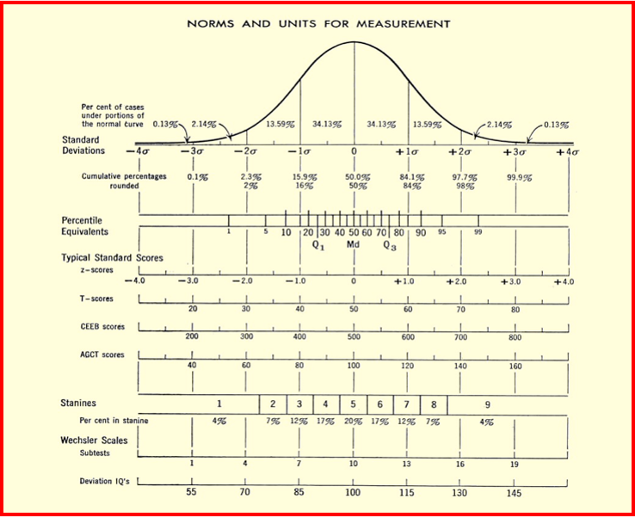
When Using Multiple Criteria, Scores Should be Normalized for Comparison Purposes
Notes:
A very common error during the identification process occurs when scores are combined from multiple sources of data. Since not all tests use the same measurement scale when reporting the results, it is very important when making comparisons between multiple measures to “normalize” the data. Normalizing data is the process of converting different types of data on the same scale for comparison purposes (i.e., converting to a z-score). By definition a z-score tells us how far a student is above or below the average student in our local population.
For further information on this process, please refer to the references.
Resource:
Ryan, S. (2011). Normalizing data for identification of gifted students. Unionville, NY: Royal Fireworks Press.

Slide 28
Considerations for Using Multiple Measures for Gifted Identification a Valid Approach
Consider all components of the state or districts definition of giftedness
Use the most up-to-date version of any standardized assessment
Study the norms of all standardized assessments used in your identification process
Use multiple measures detailed through this module
Integrate multiple sources of data in a technically defensible way
Consider measurements of error
Build student profiles
Identification committees involving professionals with a background in assessment
Notes:
Consider these practices when using multiple measures to identify students for special services. If you design and use a matrix and the scores are combined that result in one number, you lose some valuable information about a child’s strengths, which guides future programming. However, the use of matrices may be more efficient in larger school districts (see references).
Do not add scores together if instruments are commonly reported on different measurement scales (e.g., percentiles on one instrument and raw scores on another instrument).
Do not compare test results on different tests before you convert them to a standard score (such as a z-score or national curve equivalent score). A common method for putting all data on the same scale is to convert everything to a z-score. The z-score is a common yard stick for all types of data. Information about these conversions can be found on the Internet.
When trying to obtain valid information about a student’s status and needs, a variety of assessment procedures should be used (Moon, 2013). Her list of recommendations regarding what makes for a comprehensive gifted identification system are worth noting:
Consider all components of the definition of giftedness as defined by the respective state and district. Multiple assessments should be used that reflect each category of giftedness outlined in the definition.
Use the most up-to-date version of any standardized assessment that is supported by strong psychometric data to inform the decisions that will be made about gifted placement.
Undertake careful study of the norms of all standardized assessments used in an identification process to ensure that they are up-to-date and representative of the types of students that are being targeted for gifted services.
Use multiple measures, including both standardized and non-standardized assessments, as well other data sources including:
interviews with parent/guardians, teachers, other relevant professionals, and if appropriate, the student;
direct observations of the student in a variety of settings and on more than one occasion;
curriculum-based measures designed specifically to elicit the types of knowledge, skills, and understandings that are the focus of the gifted services; and
student portfolios.
Integrate these multiple sources of data in a technically defensible way. One consideration is to investigate the incremental validity of particular sources of data. For example, does the use of an interest survey provide a significantly better result for a decision about gifted programming than use only of a group-administered achievement test and ability test? If it is found that the interest survey significantly aids in the decision, then using the interest form is said to have incremental validity.
Consider confidence intervals and standard error of measurement, if appropriate, when making decisions about placement. Confidence intervals are included in text manuals and provide a range in which a student’s test score would be likely to fall if he or she were tested over several occasions. This interval allows for test error to be considered in interpreting a score.
Adhere to recommended and accepted practices for the administration, scoring, interpretation, and reporting of standardized assessments.
Develop case studies/profiles of students. The purpose of the case study is to provide a deeper understanding of a student’s particular strengths, interests, abilities, motivation, and/or learning profile. Case studies include student data across multiple sources of information representing various areas of the gifted definition.
An identification and placement committee made up of professionals with a background in assessment and gifted education should discuss the information gathered from all data sources in a balanced way to determine if the student’s current level of academic performance and skills suggests a need for modifications in educational planning and what those modifications should mean (pp. 133-134).
Reference:
Moon, T. R. (2013). Uses and misuses of matrices in identifying gifted students. In C. M. Callahan & H. L. Hertberg-Davis (Eds.), Fundamentals of gifted education: Considering multiple perspectives (pp.128-134). New York: Routledge, Taylor and Francis Group.

Slide 29
Recommendations for Using Standardized Assessments
Obtain the most reliable and valid measures of domain-specific aptitude for all students.
Provide and document appropriate procedures for test takers with disabilities who need special accommodations or those with diverse linguistic backgrounds.
Provide adequate training to those administrating the assessments and ensure and monitor the accuracy of the scoring process.
Establish a policy for achieving more equitable representation of underrepresented groups in programs.
Make better use of local norms when identifying students whose accomplishments in particular academic domains are well above their classmates.

Slide 30
Activity 2: Reflection – Understanding Psychometrics
List the instruments that you are currently using in your identification plan to identify students for highly capable services. Reflect on the importance of understanding the purpose and intent of each of these instruments.
What do you now understand about the strengths and limitations of the instruments that you are using to identify students for highly capable services?
Are these instruments valid and reliable, and being used appropriately?

Slide 31
Teacher Perspectives: Using Teacher Rating Scales
Notes:
The most common rationale behind the use of teacher judgment scales is that they provide additional information about the characteristics and behaviors associated with giftedness (Westberg, 2012). Lohman and Lakin (2007) also argue for the inclusion of teacher judgment measures when identifying students for gifted services, stating that “Combining evidence of current achievement, reasoning abilities, and teacher ratings can help increase the diversity of gifted programs while also identifying the students in all ethnic groups most likely to benefit from special instruction” (p. 22). In her chapter Using Teacher Rating Scales in the Identification of Gifted Students (Westberg, 2012), she evaluated 3 instruments that have empirical support for their use. She offers advice when using teacher judgement measures in the identification process:
Screening and identification procedures and instruments should align with the definition and services for which we are identifying students. For example, if a district is providing advanced classes in language arts and mathematics, then it is important to select instruments that better match the talent being served.
Modifying teacher judgment instruments is not permissible since the reliability, validity, and technical support for the instrument will be compromised.
Scores from each scale on the instrument should not be added together, because valuable data is lost about a child’s unique strengths.
Teacher training is very important before asking teachers to complete teacher-rating forms. Additionally, she cites research that has found that teachers helping teachers focus on particular manifestations of traits in specific cultural or socioeconomic setting would improve the predictive validity of the ratings (Hunsaker, Finley, & Frank, 1997), while Gear (1978) found that trained teachers nominate more students than untrained teachers.
References:
Gear, G. (1978). Effects of training on teachers’ accuracy in identifying gifted students. Gifted Child Quarterly, 22, 90–97.
Hunsaker, S. L., Finley, V. S., & Frank, E. L. (1997). An analysis of teacher nominations and student performance in gifted programs. Gifted Child Quarterly, 41, 19–23.
Lohman, D. L., & Lakin, J. (2007). Nonverbal test scores as one component of an identification system: Integrating ability, achievement, and teacher ratings. In J. Van Tassel Baska (Ed.), Alternative assessments for identifying gifted and talented students (pp. 41–66). Waco, TX: Prufrock Press.
Westberg, K. L. (2012). Using teacher rating scales in the identification for gifted students. In S. L. Hunsaker, (Ed.)., Identification: The theory and practice of identifying students for gifted and talented education services (pp. 363-379). Mansfield Center, CT: Creative Learning Press, Inc.

Slide 32
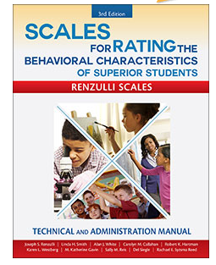
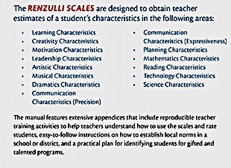
Scales for Rating the Behavioral Characteristics of Superior Students (SRBCSS)
Notes:
Background Information on the SRBCSS
This resource includes a series of 14 separate teacher judgment scales designed to obtain information about the manifestations of students’ characteristics. These characteristics are learning, motivation, creativity, leadership, artistic, musical, dramatics, communication precision, communication-expressiveness, planning, reading, mathematics, science, and technology. The first three or four scales—learning, motivation, creativity, and leadership—are most commonly used. The other scales are used when appropriate for programs that focus on those traits (Westberg, 2012).
Teacher Training Exercises Included
Grades 3-12 with the exception of Math, Reading, Technology and Science Grades 3-8
Links to SRBCSS: http://www.prufrock.com/Scales-for-Rating-the-Behavioral-Characteristics-of-Superior-Students-Technical-and-Administration-Manual-3rd-ed-P1823.aspx
References:
Renzulli, J. S., Smith, L. H., White, A. J., Callahan, C. M. Hartman, R. K., Westberg, K. W., Gavin, M. K., Reis, S. M., Siegle, D., & Sytsma Reed, R. E. (2010). Scales for Rating the Behavioral Characteristics of Superior Students (3rd ed.) [published instrument]. Waco, TX: Prufrock Press.
Westberg, K. L. (2012). Using teacher rating scales in the identification for gifted students. In S. L. Hunsaker, (Ed.)., Identification: The theory and practice of identifying students for gifted and talented education services (pp. 363-379). Mansfield Center, CT: Creative Learning Press, Inc.

Slide 33
Gifted Rating Scales (GRS)
Administration: 5-10 minutes
Level/Publication Date: 2003
Ages/Grades: GRS-P: 4.0 through 6.11 years GRS-S: 6.0 through 13.11 years
6 Scales: intellectual, academic, creativity, artistic, leadership, and motivation
Notes:
Background Information About the GRS
The Gifted Rating Scales are norm-referenced rating scales. These scales are based on current theories of giftedness, as well as federal and state guidelines regarding the definition of gifted and talented students. Pre-school and Kindergarten teachers complete the Pre-School/Kindergarten GRS-P form for children between the ages of 4:0 and 6:11 years. This form of GRS–P contains brief scales covering five domains: intellectual, academic readiness, motivation, creativity, and artistic talent. Teachers complete six brief scales on the School-Age GRS–S form to evaluate children between the ages of 6:0 through 13:11 years who are in grades 1 - 8. The six domains include: intellectual, academic, motivation, creativity, leadership, and artistic talent.
Link to GRS: http://www.pearsonassessments.com/HAIWEB/Cultures/en-us/Productdetail.htm?Pid=015-8130-502
Reference:
Pfeiffer, S. I., & Jarosewich, T. (2003). GRS: Gifted Rating Scales [published instrument]. San Antonio, TX: Pearson.

Slide 34
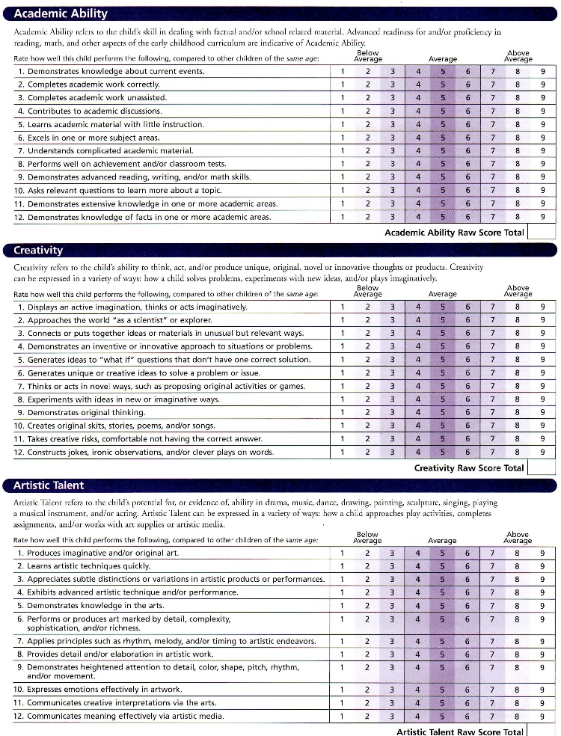
Gifted Rating Scales (GRS) Example Items
Notes:
Example items from the Gifted Rating Scales.
Link to Gifted Rating Scales (GRS)

Slide 35
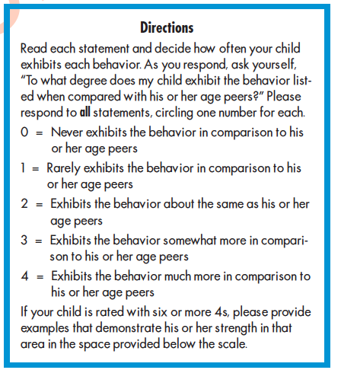
Scales for Identifying Gifted Students (SIGS)
Ryser & McConnell, 2004
Notes:
Background Information About the SIGS
The Scales for Identifying Gifted Students (SIGS) is a series of scales “designed to assist school districts in the identification of students as gifted” (Ryser & McConnell, 2004, p. 1). The SIGS contains items on seven separate scales: general intellectual ability, language arts, mathematics, science, social studies, creativity, and leadership. Teachers rate each scale on a 5-point range (0 = never, 1 = rarely, 2 = some, 3 = somewhat more, 4 = much more). Teachers are asked to respond to items by keeping in mind how each child compares to his or her peers on the characteristic being rated. SIGS has both a home and school version. This rating scales are meant for ages 5 through 18.
Link to SIGS: http://www.prufrock.com/SIGS-Complete-Kit-Scales-for-Identifying-Gifted-Students-P123.aspx
Reference:
Ryser, G. R., & McConnell, K. (2004). SIGS complete kit: Scales for Identifying Gifted Students [published instrument]. Waco, TX: Prufrock Press.

Slide 36
Selection Phase – Using Multiple Criteria
Notes:
During the selection phase, the Multidisciplinary Selection Committee meets to select students who will benefit from specified highly capable services. All data from the screening and referral phases should be considered. While there are no prescribed ways to use the criteria, committees should use ALL of the data collected to find the strengths of a student in order to consider the variety of services that may be available.

Slide 37
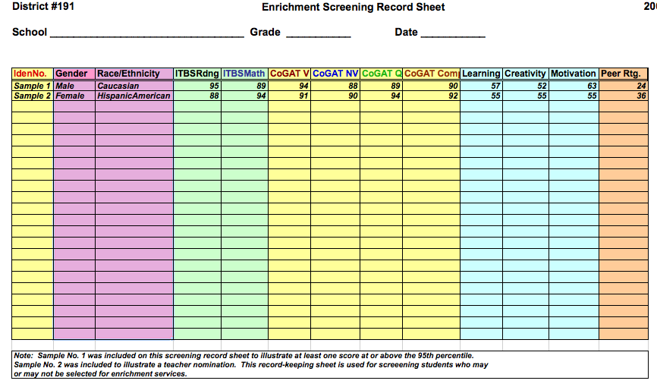
Recommendations for using Multiple Criteria: Building a Student Profile
Notes:
This is one example of how a spreadsheet can be used to view student scores from multiple assessments. This is a holistic method for reviewing scores rather than using a matrix, which applies weights to various data points. When viewing scores holistically, the selection committee determines eligibility by looking across multiple sources of data rather than weighting certain sources of information or creating a formula that combines scores that might be used in a matrix. For further information on appropriate use of matrices, please see the reference below.
To interpret the scores for the Scales for Rating the Behavioral
Characteristics of Superior Students (SRBCSS), please note each scale’s total score below:
Learning Scale- 66 total
Creativity Scale-54 total
Motivation Scale-66 total
Reference:
Ryan, S. (2011). Normalizing data for identification of gifted students. Unionville, NY: Royal Fireworks Press.

Slide 38
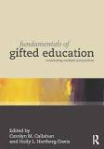
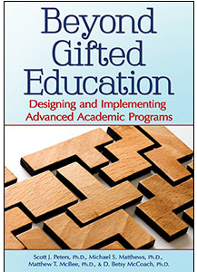
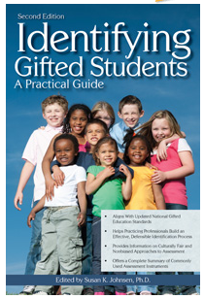
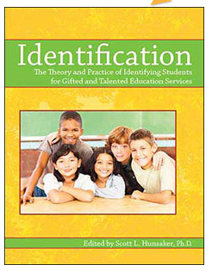
Gifted Education Texts
Callahan, C. M., & Hertberg-Davis. H. L. (Eds.) (2013). Fundamentals of gifted education: Considering multiple perspectives. NY: Routledge.
Peters, S. J., Matthews, M. S., McBee, M. T, & McCoach, B. (2014). Beyond gifted education: Designing and implementing advanced academic programs. Waco, TX: Prufrock Press.
Hunsaker, S. L. (Ed.). (2012). Identification: The theory and practice of identifying students for gifted and talented education services. Waco, TX: Prufrock Press.
Johnsen, S. K. (2011). Identifying gifted students: A practical guide. Waco, TX: Prufrock Press.
Notes:
These are some great references to support your identification plans. Consider purchasing them for your library.

Slide 39
Take Action
Examine your own district policies and procedures to assess and evaluate the degree to which you are using multiple sources of data to identify and consider the services needed to match your students’ learning needs.
Possible Action Steps:
Revise identification procedures if needed to reflect your new knowledge about the use of multiple criteria.
Develop procedures for a holistic review of collected student data.
Redesign the criteria used for selecting highly capable students based on what you have learned in this module and the cautionary suggestions that are made when an identification system is considered.
Add some new services based on what the data reveal to you about students’ needs.
Create a professional development plan for educating those in your school district who will have a role in the identification and selection of students for highly capable programs.
Notes:
Reflection based upon new knowledge helps us to continually “grow” our programs. What ”new changes” are necessary to improve how you use multiple sources of data when identifying students for your highly capable program? Use these “Take Action” ideas or design your own that are more relevant to your needs to “jumpstart” the change process.
Examine your own district policies and procedures to assess and evaluate the degree to which you are using multiple sources of data to identify and consider the services needed to match your students’ learning needs.
Possible Action Steps:
Revise identification procedures if needed to reflect your new knowledge about the use of multiple criteria.
Develop procedures for a holistic review of collected student data.
Redesign the criteria used for selecting highly capable students based on what you have learned in this module and the cautionary suggestions that are made when an identification system is considered.
Add some new services based on what the data reveal to you about students’ needs.
Create a professional development plan for educating those in your school district who will have a role in the identification and selection of students for highly capable programs.

Slide 40
Credits
Jann H. Leppien, Ph.D.
Nancy B. Hertzog, Ph.D.
Rachel U. Mun (née Chung), Ph.D.
Contact: jleppien@whitworth.edu
8/01/16

Slide 41
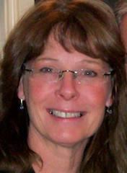
Lead Author Bio
Jann H. Leppien, Ph.D.
Module Writer
Margo Long Endowed Chair in Gifted Education
Center for Gifted Education,
Whitworth University, Spokane, Washington
Notes:
Picture Source: Jann Leppien
Dr. Jann Leppien is an associate professor and the Endowed Chair in Gifted Education at Whitworth University. Whitworth's Center for Gifted Education supports and develops policies and practices that encourage the diverse expressions of gifts and talents in children and youth from all cultures, racial and ethnic backgrounds, and socioeconomic groups and offers educators a specialty endorsement and master’s degrees in gifted education. Prior to this position, she taught courses at the University of Great Falls in Montana in curriculum and assessment, gifted education, and educational research. Before joining the faculty at the University of Great Falls, she worked as a research assistant for The National Research Center on the Gifted and Talented (NRC/GT) at the University of Connecticut, where she obtained a master’s and Ph.D. in gifted education. She has been a classroom teacher, enrichment specialist, and coordinator of a gifted education program in Montana. She is the co-author of The Multiple Menu Model: A Practical Guide for Developing Differentiated Curriculum, and The Parallel Curriculum: A Design to Develop High Potential and Challenge High-Ability Students. She conducts workshops for teachers in the areas of differentiated instruction, curriculum design and assessment, thinking skills, and gifted program development. She has served on the board of the National Association for Gifted Children and currently serves on the Awards Committee. She is also a board member of the Association for the Education of Gifted Underachieving Students (AEGUS) and serves on the advisory board of the 2e Center for Research and Professional Development located on the campus of Bridges Academy, a school for twice-exceptional students (http://www.bridges.edu). She is President of Edufest, a summer teaching and learning institute in gifted education held in Boise, Idaho (www.edufest.org). Her current interest is in assisting schools in redesigning comprehensive services for highly capable students.

